Slide 1
The 2030 Agenda
The inclusion of persons with disabilities
the way forward: THE Role of the International Disability Sector
Dr. Elizabeth Lockwood

Slide 2
Introduction
The International Disability Alliance (IDA) advances the human rights of persons with disabilities as a united voice of four regional and eight global organizations of persons with disabilities (DPOs).
The International Disability and Development Consortium (IDDC) is a global network of 26 disability and development NGOs and organizations of persons with disabilities working in more than one hundred countries around the world.
Both IDA and IDDC members have been active in the process that shaped the 2030 Agenda

Slide 3
2030 Agenda Trainings
National and Regional Trainings
  Carried out in partnership as IDA, IDDC, and DRF
  Over 300 persons with disabilities and allies attended
  San Francisco (DRF)
  Kenya and East Africa region (EDAN)
  Malawi (DRF)
  Washington DC (InterAction/DRF)
  Bangkok (Republic of Korea, Philippines)
  Mexico City (regional)
  Cairo (CBM support)
  Morocco (HI support)
  Rwanda (DRF)
  Peru – in Spanish (CBM support, August)

Slide 4
Discussion
What do you know about the MDGs?
What do you know about the 2030 Agenda and the Sustainable Development Goals (SDGs)?

Slide 5
Comparing the MDGs and the 2030 Agenda
Millennium Development Goals (MDGs) | 2030 Agenda
Adopted in 2000 and ended in 2015 | Adopted in 2015 and ends in 2030
Focus on developing countries | Universal, applies to all countries
To reduce extreme poverty | To eradicate poverty in all its forms and and to realize economic empowerment through sustainable development
8 goals and 18 targets with 48 indicators | 17 goals and 169 targets with 230 global indicators
No references to persons with disabilities | 7 references in SDGs: education (2), employment, reducing inequalities, inclusive cities (2), disaggregation of data by disability (All together 11 in Agenda 2030 and 11 in global indicators)

Slide 6
Transforming our World: the 2030 Agenda for Sustainable Development
On 25 September 2015, world leaders adopted the 2030 Agenda
“It was the first time in human history that we as human beings reached consensus on the future of development.”
  – UN DESA’s Under-Secretary-General Wu Hongbo
We could be the first generation to succeed in ending poverty everywhere.
Notes:
“It was the first time in human history that we as human beings reached consensus on the future of development,” UN DESA’s Under-Secretary-General Wu Hongbo

Slide 7
Transforming our World: the 2030 Agenda for Sustainable Development
Heads of State and Governments committed to:
  building a better future for all people, including millions denied the chance to lead decent, dignified and rewarding lives and to achieve their full human potential;
  succeeding in ending poverty, reducing inequalities, and saving the planet from ecological degradation and climate change.

Slide 8
Overview
The 2030 Agenda was the outcome of the post-2015 intergovernmental negotiations. The 2030 Agenda is a substantive 35-page document containing five sections:
Preamble
Declaration
Sustainable Development Goals and targets
Means of implementation and the Global Partnership
Follow-up and Review

Slide 9
Overview
To ensure its success, the Agenda must remain of the people, by the people and for the people, committing the world to global action for the next 15 years.
The implementation of the Agenda is a roadmap to a better future for humanity and our planet, all of us are responsible for ensuring that the journey is successful and its gains sustainable.

Slide 10
Political balance of the 2030 Agenda
The political balance of the Agenda can be summarized as: Universal Ambition vs. National Ownership
The Declaration defines the concept of national ownership as a counterweight to its universality, which is reflected and reinforced throughout the entire Agenda:
“This is an Agenda of unprecedented scope and significance. It is accepted by all countries and is applicable to all, taking into account different national realities, capacities and levels of development and respecting national policies and priorities” (para 5)

Slide 11
Sustainable Development Goals (SDGs): Background
The SDGs were developed by the UN Open Working Group on Sustainable Development between March 14, 2013 to July 19, 2014.
The post-2015 intergovernmental negotiations (January 19 to August 2, 2015) took over the SDGs with minor changes.
The SDGs became an integral part of the 2030 Agenda, but it is important to keep in mind that the SDGs are just one of the 2030 Agenda chapters, among the Preamble, Declaration, Sustainable Development Goals and targets, Means of implementation and the Global Partnership, Follow-up and Review.

Slide 12
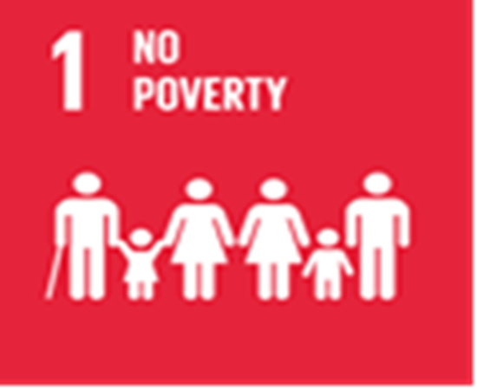

UNFINISHED BUSINESS OF THE MDGS (SDGS 1-5)

Slide 13
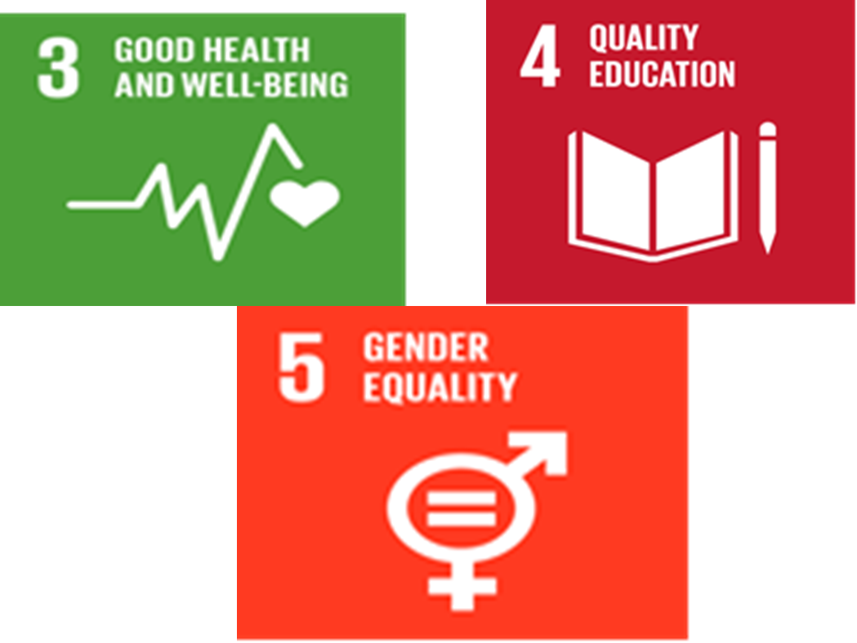
UNFINISHED BUSINESS OF THE MDGS- (SDGS 1-5)CONT’

Slide 14
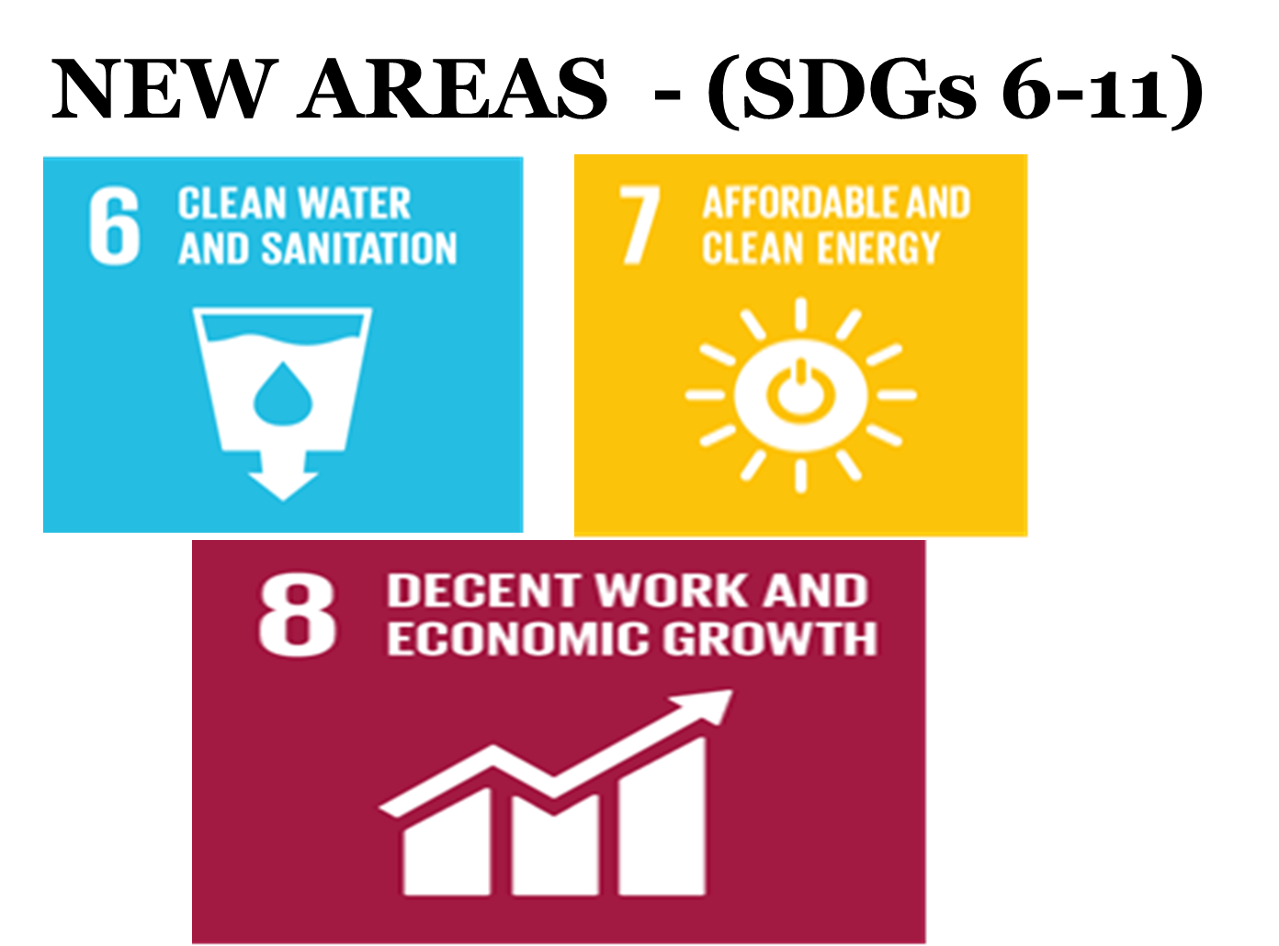
NEW AREAS - (SDGs 6-11)

Slide 15
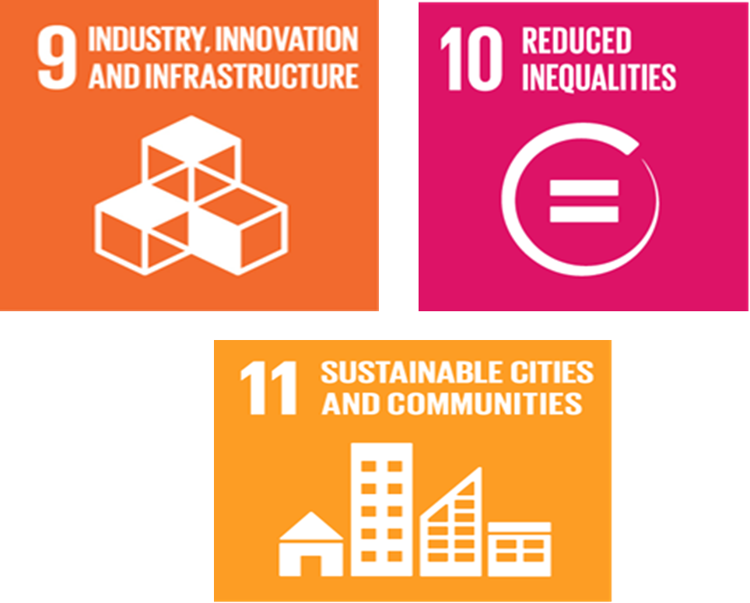
NEW AREAS - (SDGs 6-11) CONT’

Slide 16
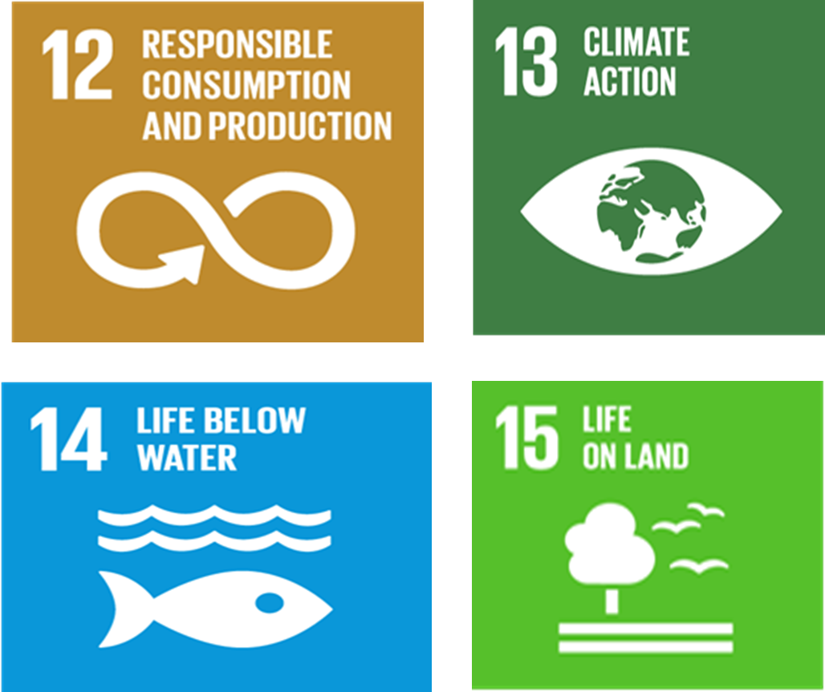
GREEN AGENDA - (SDGS 12-15)

Slide 17

GOVERNANCE/PEACE - (SDGS 16)

Slide 18

MEANS OF IMPLEMENTATION - (SDG 17)

Slide 19
Sustainable Development Goals: Inclusive and for all
1. End poverty in all its forms everywhere
2. End hunger, achieve food security and improved nutrition and promote sustainable agriculture
3. Ensure healthy lives and promote well-being for all at all ages
4. Ensure inclusive and equitable quality education and promote lifelong learning opportunities for all
5. Achieve gender equality and empower all women and girls
6. Ensure availability and sustainable management of water and sanitation for all
7. Ensure access to affordable, reliable, sustainable and modern energy for all

Slide 20
Sustainable Development Goals: Inclusive and for all
8. Promote sustained, inclusive and sustainable economic growth, full and productive employment and decent work for all
9. Build resilient infrastructure, promote inclusive and sustainable industrialisation and foster innovation
10. Reduce inequality within and among countries
11. Make cities and human settlements inclusive, safe, resilient and sustainable
12. Ensure sustainable consumption and production patterns
13. Take urgent action to combat climate change and its impacts (acknowledging that the United Nations Framework Convention on Climate Change is the primary international, intergovernmental forum for negotiating the global response to climate change)

Slide 21
Sustainable Development Goals: Inclusive and for all
14. Conserve and sustainably use the oceans, seas and marine resources for sustainable development
15.Protect, restore and promote sustainable use of terrestrial ecosystems, sustainably manage forests, combat desertification, and halt and reverse land degradation and halt biodiversity loss
16.Promote peaceful and inclusive societies for sustainable development, provide access to justice for all and build effective, accountable and inclusive institutions at all levels
17. Strengthen the means of implementation and revitalise the global partnership for sustainable development

Slide 22
SDGs and the inclusion of persons with disabilities
Out of 17 Goals, 13 are particularly related to persons with disabilities, but only 7 targets have an explicit reference.
A number of other Goals and targets reference vulnerable groups and thus include persons with disabilities because of the reference in paragraph 23 of the 2030 Agenda Preamble.
The inclusive phrasing of many Goals and targets, also make them implicitly applicable for persons with disabilities, such as those referencing “for all” or “all women and men.”
Even without any such references, all Goals and targets will be applicable to persons with disabilities by simple virtue of the universality, which applies to all, and the overarching principle of “leave no one behind”

Slide 23
Explicit references to Persons with Disabilities
Persons with disabilities are referenced 11 times in the 2030 Agenda:
Declaration
  Human rights (paragraph 19)
  Vulnerable groups (paragraph 23)
  Education (paragraph 25)

Slide 24
Explicit references to Persons with Disabilities
Sustainable Development Goals and targets
  Goal 4: education – 2 References
  Goal 8: employment – 1 Reference
  Goal 10: reducing inequalities – 1 Reference
  Goal 11: inclusive cities – 2 References
  Goal 17: means of implementation, data – 1 Reference
Follow-up and review
  Data disaggregation (paragraph 74, g)

Slide 25
References to “vulnerable”
“People who are vulnerable must be empowered. Those whose needs are reflected in the Agenda include all children, youth, persons with disabilities (of whom more than 80 per cent live in poverty)” –(para 23)
This paragraph is particularly strong because it calls for the empowerment of “vulnerable” people and places persons with disabilities at the centre of poverty eradication throughout the entire Agenda.
Whenever “vulnerable” is referenced throughout the Agenda (18 times), these provisions directly apply to persons with disabilities.
The disability movement prefers the term “at risk” rather than “vulnerable,” but “vulnerable” is more broadly accepted by governments at the UN. Due to the political sensitivity of the 2030 Agenda negotiations it was not possible to change this term.

Slide 26
Education
Goal 4. Ensure “inclusive” and equitable quality education and promote lifelong learning opportunities “for all”
4.5 By 2030, eliminate gender disparities in education and ensure “equal access to all levels of education” and vocational training for the vulnerable, including persons with “disabilities,” indigenous peoples and children in vulnerable situations
4.a Build and upgrade education facilities that are child, “disability” and gender sensitive and provide safe, non-violent, inclusive and effective learning environments “for all”
4.a.1 Percentage of schools with access to (i) electricity; (ii) Internet for pedagogical purposes; (iii) computers for pedagogical purposes; (iv) “adapted infrastructure and materials for students with disabilities;” (v) single-sex basic sanitation facilities; (vi) basic handwashing facilities (as per the WASH indicator definitions)

Slide 27
Employment
Goal 8. Promote sustained, “inclusive” and sustainable economic growth, full and productive employment and decent work “for all”
8.5 By 2030, achieve full and productive employment and decent work for “all women and men,” including for “young people” and “persons with disabilities,” and equal pay for work of equal value
8.5.1 Average hourly earnings of female and male employees by occupation, by “age group” and “persons with disabilities”
8.5.2 Unemployment rate, by sex, “age group” and “persons with disabilities”

Slide 28
The SDGs and the UN CRPD
Implementing the SDGs must be in line with and build upon existing international and national commitments and mechanisms
The SDGs draw particular attention and commitment to empower persons with disabilities under a number of Goals and targets that are also found in the UN CRPD
Therefore, the UN CRPD should serve as a guiding framework for implementing the SDGs in order to realize the full inclusion and empowerment of persons with disabilities
Only by utilizing the UN CRPD to implement the SDGs will it be ensured that exclusion and inequality are not created or perpetuated, such as institutional, attitudinal, physical, legal barriers, and barriers to information and communication technology (ICT), among other barriers to the inclusion and participation of persons with disabilities

Slide 29
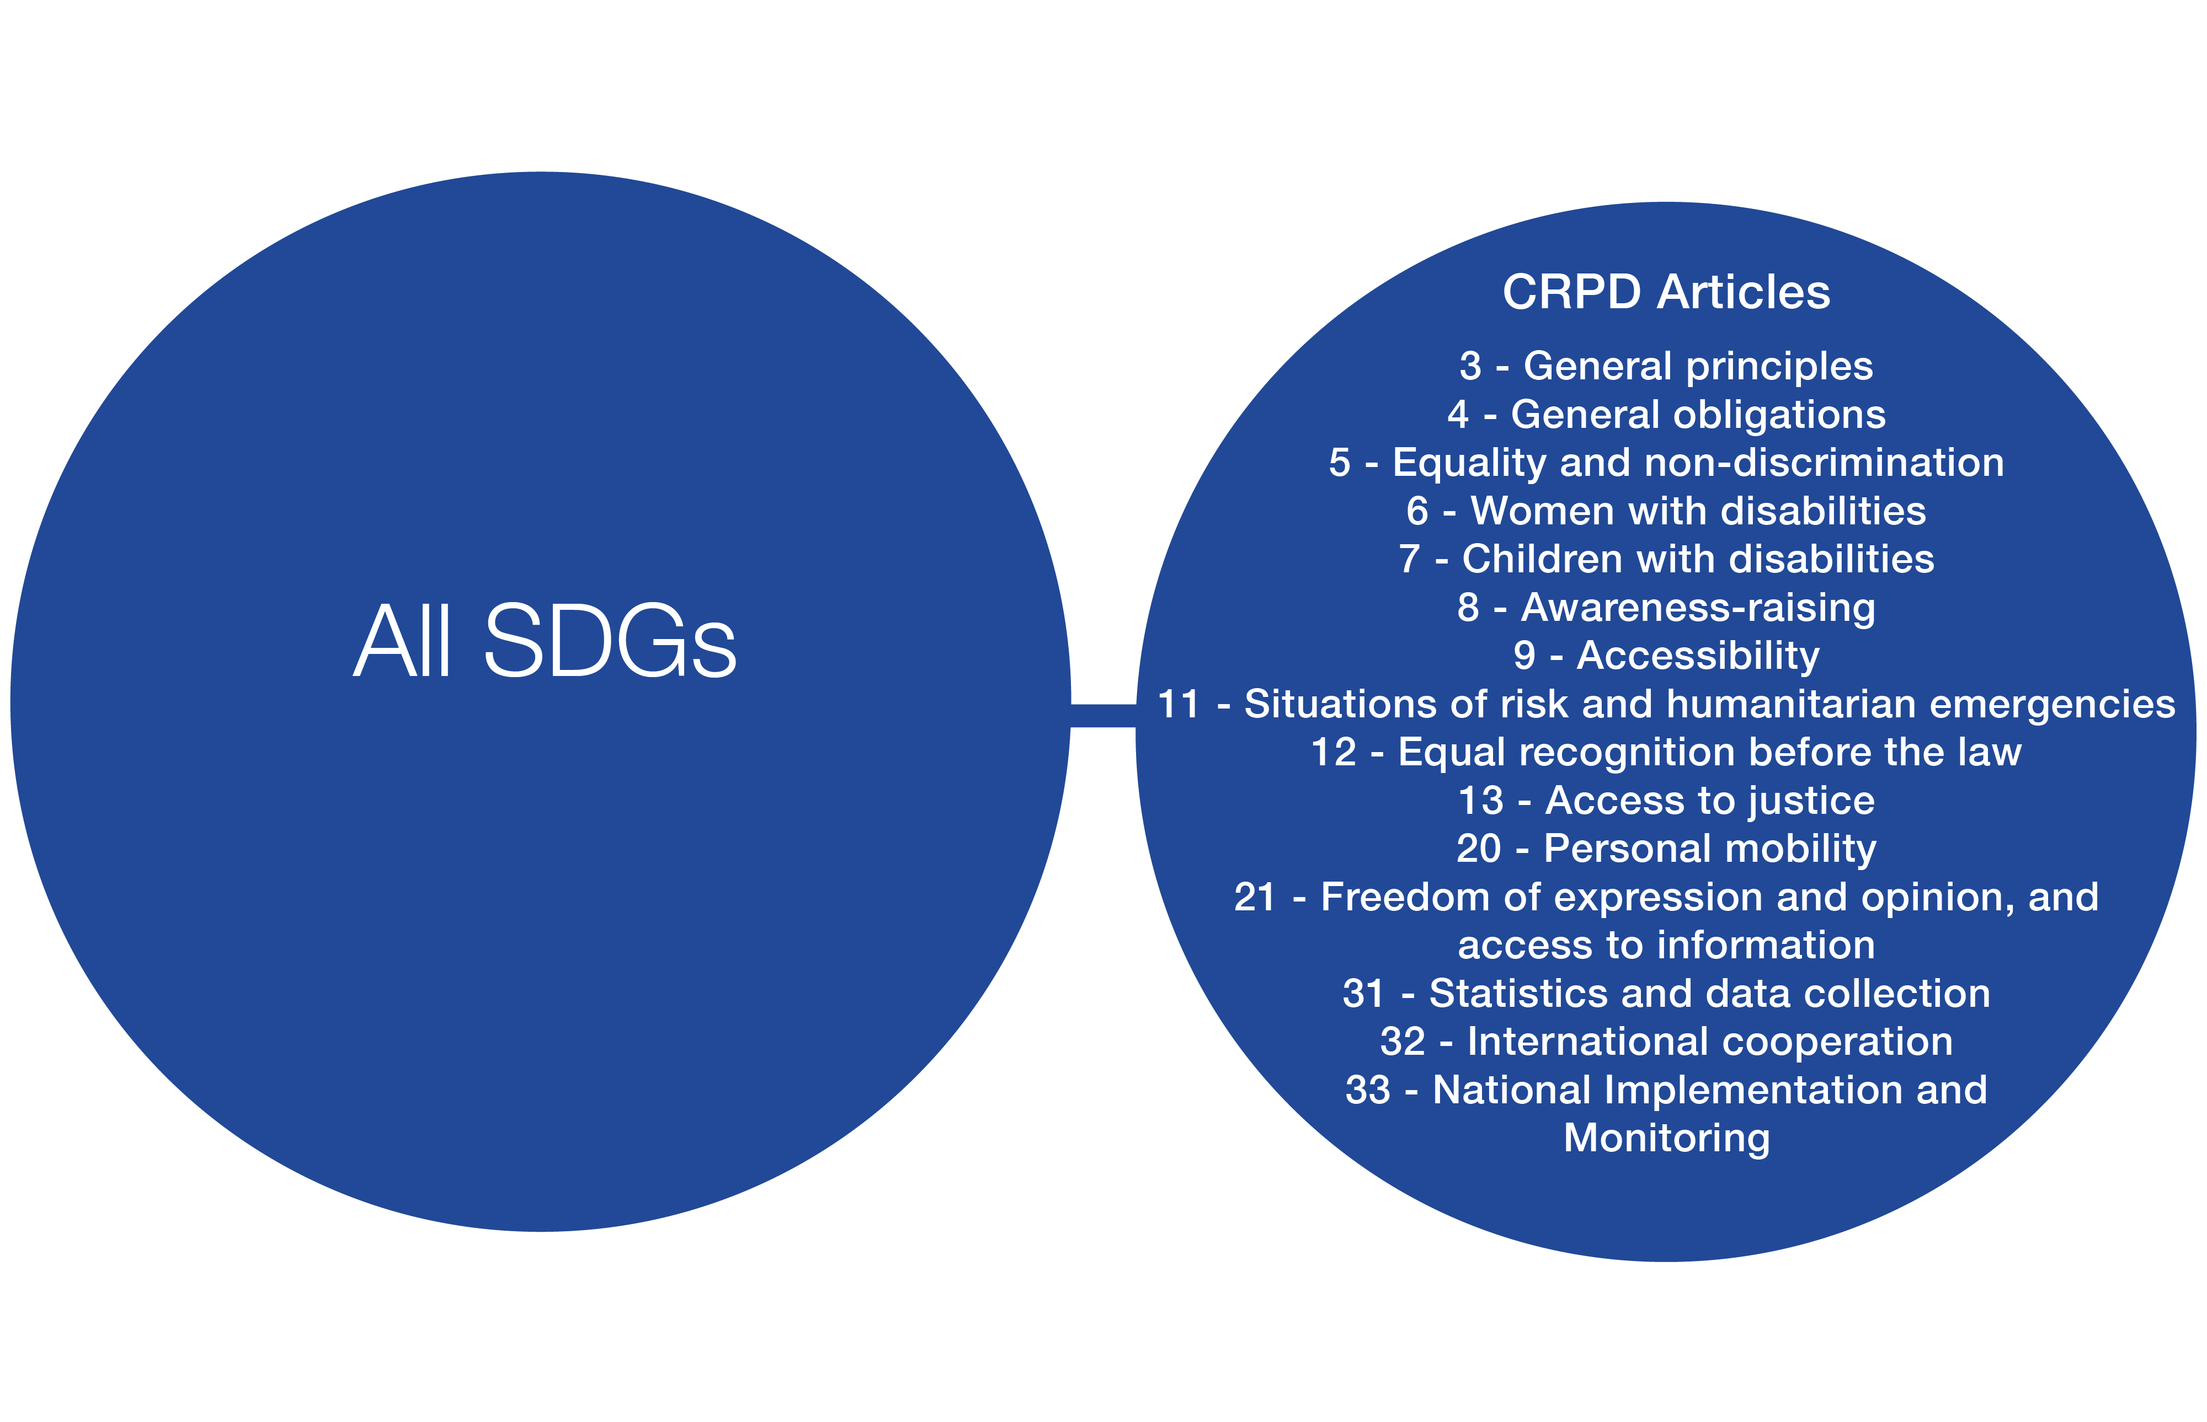
Several UN CRPD Articles are cross-cutting in nature and must always be applied and/or considered for the implementation of every Goal and target. Some examples are included below.

Slide 30
Key national strategies for DPO engagement
Key points from DPOs from East Africa, Malawi, Rwanda, and Peru
Identify entry points for advocacy for DPOs in different regions and levels of government
Build alliances among national DPOs and with disability and development organizations and broader civil society organizations across thematic areas
Work with institutions such as UNESCO, UNICEF, universities, influential individuals who can help push for change
Push for disability data, particularly disaggregation of data by disability

Slide 31
Key national strategies for DPO engagement
Engage the media as a tool for disability awareness, dissemination of information, and advocacy
Liaise with key focal points (disability and SDG) in the government and National Statistical Offices for the inclusion of persons with disabilities
Link national plans with the SDGs (e.g., Agenda 2063)
Use the CRPD as a guiding framework for SDG implementation, as well as national disability plans and laws
Prior to approaching line ministries, create a mapping that includes data of persons with disabilities, numbers of persons with disabilities, provide an analysis of the situation, write a position paper and share with the line ministry

Slide 32
Key national strategies for DPO engagement
Create an advocacy project per Goal and carry out evidence-based projects and share findings with different stakeholders
Collaborate as a larger disability movement to gain more effective entry points in national advocacy.
Carry out training on accessibility and advocacy for different DPO leaders to strengthen DPOs and to unify the disability movement.

Slide 33
Thank you!

Slide 34
References
2030 Agenda sustainabledevelopment.un.org/post2015/transformingourworld
Funding For Development
www.un.org/esa/ffd/ffd3
HLPF Resolution
https://sustainabledevelopment.un.org/hlpf
Beijing Platform for Action
http://beijing20.unwomen.org/en/about
DRR Outcome
http://www.unisdr.org/we/coordinate/sendai-framework

