Slide 1
The 2030 Agenda
The inclusion of persons with disabilities
Comprehensive Guide

Slide 2
Introduction
The International Disability Alliance (IDA) advances the human rights of persons with disabilities as a united voice of four regional and eight global organizations of persons with disabilities (DPOs).
The International Disability and Development Consortium (IDDC) is a global network of 26 disability and development NGOs and organisations of persons with disabilities working in more than one hundred countries around the world.
Both IDA and IDDC members have been active in the process that shaped the 2030 Agenda
This guide presents information about the 2030 Agenda, how it connects to the UN Convention on the Rights of Persons with Disabilities, and explores potential entry points for persons with disabilities to influence and participate in their implementation, follow-up and review

Slide 3
Transforming our World: the 2030 Agenda for Sustainable Development
On 25 September 2015, world leaders adopted the 2030 Agenda
“It was the first time in human history that we as human beings reached consensus on the future of development.”
  – UN DESA’s Under-Secretary-General Wu Hongbo
We could be the first generation to succeed in ending poverty everywhere.
Notes:
“It was the first time in human history that we as human beings reached consensus on the future of development,” UN DESA’s Under-Secretary-General Wu Hongbo

Slide 4
Transforming our World: the 2030 Agenda for Sustainable Development
Heads of State and Governments committed to:
  building a better future for all people, including millions denied the chance to lead decent, dignified and rewarding lives and to achieve their full human potential;
  succeeding in ending poverty, reducing inequalities, and saving the planet from ecological degradation and climate change.

Slide 5
Overview
The 2030 Agenda was the outcome of the post-2015 intergovernmental negotiations. The 2030 Agenda is a substantive 35-page document containing five sections:
Preamble
Declaration
Sustainable Development Goals and targets
Means of implementation and the Global Partnership
Follow-up and Review

Slide 6
Overview
To ensure its success, the Agenda must remain of the people, by the people and for the people, committing the world to global action for the next 15 years.
The implementation of the Agenda is a roadmap to a better future for humanity and our planet, all of us are responsible for ensuring that the journey is successful and its gains sustainable.

Slide 7
The 2030 Agenda
VISION
— & —
PRINCIPLES
Reflected in declaration
SDGs
Global Partnership
Means of Implementation (MoIs)
IMPLEMENTATION
RESULTS FRAMEWORK
Sustainable
Development
Goals
FOLLOW-UP & REVIEW
Image with thanks to the UN: sustainabledevelopment.un.org
Notes:
Facilitator needs to clarify:
Organization of this diagram (why vision is at the top, and review & follow-up is shown as foundation, and so on)
How the MDGs were simply a results framework, so the Post-2015 agenda is much more (especially with the vision at the top)

Slide 8
Political balance of the 2030 Agenda
The political balance of the Agenda can be summarized as: Universal Ambition vs. National Ownership
The Declaration defines the concept of national ownership as a counterweight to its universality, which is reflected and reinforced throughout the entire Agenda:
“This is an Agenda of unprecedented scope and significance. It is accepted by all countries and is applicable to all, taking into account different national realities, capacities and levels of development and respecting national policies and priorities” (para 5)

Slide 9
Political balance of the 2030 Agenda
National ownership means States are committed to implement the Agenda, but only within their own nationally defined limits. Thus, States are permitted to prioritize and carry out what they consider to be nationally acceptable.
This balance is necessary because the Agenda is a political commitment, not a legally binding document.

Slide 10
Inclusion of persons with disabilities
Persons with disabilities were not included in the Millennium Development Goals (MDGs) and consequently excluded from many development initiatives and funding streams.
In contrast, the 2030 Agenda includes persons with disabilities.

Slide 11
Comparing the MDGs and the 2030 Agenda
Millennium Development Goals (MDGs) | 2030 Agenda
Adopted in 2000 and end in 2015 | Adopted in 2015 and end in 2030
Focus on developing countries | Universal, applies to all countries
To reduce extreme poverty | To eradicate poverty in all its forms and and to realize economic empowerment through sustainable development
8 goals and 18 targets with 48 indicators | 17 goals and 169 targets with 231 global indicators
No references to persons with disabilities | 7 references in SDGs: education (2), employment, reducing inequalities, inclusive cities (2), disaggregation of data by disability (All together 11 in Agenda 2030 and 9 in global indicators)

Slide 12
Explicit references to Persons with Disabilities
Persons with disabilities are referenced 11 times in the 2030 Agenda:
Declaration
  Human rights (paragraph 19)
  Vulnerable groups (paragraph 23)
  Education (paragraph 25)

Slide 13
Explicit references to Persons with Disabilities
Sustainable Development Goals and targets
  4,5. Goal 4: education – 2 References
  6. Goal 8: employment – 1 Reference
  7. Goal 10: reducing inequalities – 1 Reference
  8,9. Goal 11: inclusive cities – 2 References
  10. Goal 17: means of implementation, data – 1 Reference
Follow-up and review
  11. Data disaggregation (paragraph 74, g)

Slide 14
References to ‘vulnerable’
“People who are vulnerable must be empowered. Those whose needs are reflected in the Agenda include all children, youth, persons with disabilities (of whom more than 80 per cent live in poverty)”
- paragraph 23
This paragraph is particularly strong because it calls for the empowerment of ‘vulnerable’ people and places persons with disabilities at the centre of poverty eradication throughout the entire Agenda.

Slide 15
References to ‘vulnerable’
Including persons with disabilities among vulnerable people means that whenever ‘vulnerable’ is referenced throughout the Agenda (18 times), these provisions directly apply to persons with disabilities.
The disability movement prefers the term “at risk” rather than “vulnerable,” but “vulnerable” is more broadly accepted by governments at the UN. Due to the political sensitivity of the 2030 Agenda negotiations it was not possible to change this term.

Slide 16
Other references to persons with disabilities
2030 Agenda references a number of UN documents that include references to persons with disabilities:
Beijing Platform for Action has 24 references to persons with disabilities
Sendai Framework for Disaster Risk Reduction 2015-2030 has 5 references to persons with disabilities and an additional two references on universal design
SIDS Accelerated Modalities of Action (SAMOA) Pathway has 10 references to persons with disabilities

Slide 17
Other references to persons with disabilities
Addis Ababa Action Agenda, the outcome document of the Third international Conference on Financing for Development, contains 6 references to persons with disabilities and disability, 1 to inclusive education, 1 to inclusive learning environment and 2 to accessible technologies and infrastructures
Report of the Open Working Group of the General Assembly on Sustainable Development Goals has 2 references to persons with disabilities
Resolution 67/290 the modalities resolution on High-Level Political Forum working methods: has 1 reference to persons with disabilities

Slide 18
Preamble: Background
The Preamble to the 2030 Agenda contains a brief statement on its fundamental principles
Before the final agreement, there were two draft versions of the Preamble:
  a longer more explanatory version that would have elaborated on the principles in line with the goals; the arguments against this were the risks of duplication, misinterpretation or weakening of certain goals
  a concise summary; argument for this was that it would be easier to understand, preserve the integrity of the goals, and shorten the document
The shorter version is in the final Agenda.

Slide 19
Preamble: The Five Ps
The Preamble lists five fundamental principles:
People: all human beings can fulfil their potential in dignity and equality
Planet: to protect the planet and its resources from degradation for present and future generations
Prosperity: all human beings can enjoy prosperous and fulfilling lives and that economic, social and technological progress occurs in harmony with nature
Peace: foster peaceful, just and inclusive societies which are free from fear and violence
Partnership:
  mobilize the means to implement
  focus on the poorest and most vulnerable
  with the participation of all countries, all stakeholders and all people

Slide 20
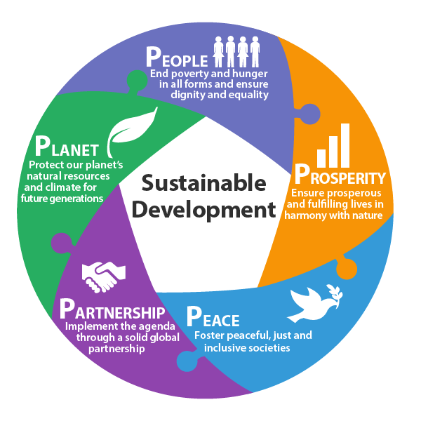
Preamble: The five Ps
Image with thanks to the UN: sustainabledevelopment.un.org
Notes:
People, Prosperity, Peace, Partnership and Planet - the five sections are linked together in an interconnected circle surrounding 'Sustainable Development'. People, End poverty and hunger in all forms and ensure dignity and equality. Prosperity, Ensure prosperous and fulfilling lives in harmony with nature. Peace, Foster peaceful, just and inclusive societies. Partnership, Implement the agenda through a solid global partnership. Planet, Protect our plant's natural resources and climate for future generations.

Slide 21
Preamble: Persons with Disabilities
“It is an Agenda of the people, by the people and for the people – and this, we believe, will ensure its success.” - 2030 Agenda, Art. 52
This call for action reflects the disability movement’s own principle:
‘Nothing About Us Without Us’

Slide 22
Preamble: Persons with Disabilities
The Agenda was created with the inclusion of persons with disabilities.
It is the responsibility of the disability movement and duty bearers to ensure that the implementation of the Agenda is carried out with the inclusion of persons with disabilities at both local and national levels.
Finally, the Agenda should be for the People, and so is to empower persons with disabilities to fully enjoy their rights as enshrined in the UN Convention on the Rights of Persons with Disabilities (UN CRPD).

Slide 23
Declaration: Background
The Declaration of the 2030 Agenda:
  Introduces the entire Agenda in a descriptive manner, makes assessments and identifies challenges
  Aims to achieve the political balance of the entire Agenda: while it intends to be ambitious and forward looking it also emphasizes the national ownership and cultural differences
  Provides space for interpretation of the Goals and targets as a means to promote and establish interlinkages
Notes:
The Declaration is very long

Slide 24
Vision of 2030 Agenda
“We envisage a world free of poverty, hunger, disease and want, where all life can thrive.” - 2030 Agenda, Art. 7
The Vision continues with a long list of aims, including these examples relevant to persons with disabilities:
  Universal literacy
  Universal access to quality education at all levels, to health care and social protection
  Commitments regarding the human right to safe drinking water and sanitation
  Respect for human rights and human dignity, equality and non-discrimination
  Equal opportunity permitting the full realization of human potential
  Just, equitable, tolerant, open and socially inclusive world in which the needs of the most vulnerable are met

Slide 25
The framing of Sustainable Development
“Sustainable development recognizes that eradicating poverty in all its forms and dimensions, combating inequality within and among countries, preserving the planet, creating sustained, inclusive and sustainable economic growth and fostering social inclusion are linked to each other and are interdependent.”
- 2030 Agenda, Art. 13
Notes:
Refer back to slides on conferences referencing persons with disabilities

Slide 26
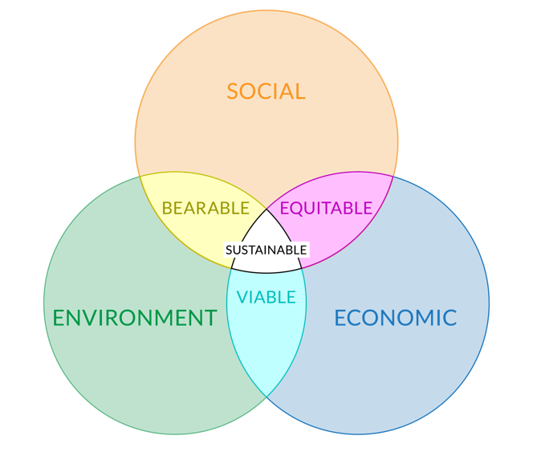
The framing of Sustainable Development
Image with thanks to the UN: sustainabledevelopment.un.org - adapted from Adams, WM (2006)
Notes:
Venn Diagram of Sustainable Development - Three main rings all overlap each other: Social, Economic and Environment. Social and Economic overlap is Equitable. Economic and Environment overlap is Viable. Environment and Social overlap is Bearable. Centre, with all overlapping, is Sustainable.

Slide 27
Declaration: About the new Agenda
Strong provision to respect, protect and promote human rights and fundamental freedoms for all, without distinction of any kind, including disability
Particular attention will be given to countries and regions most in need and to the most vulnerable populations
Gender equality and empowerment of all women and girls are critical issues and should be ensured as well as gender must be mainstreamed in a systematic way

Slide 28
Declaration: About the new Agenda
Means of Implementation is outlined: financial and non-financial
Follow-up and review will mainly be the responsibility of Member States
The critical role of data in assessing progress and evidence-based decisions
Explains goals and establishes the interlinkages between them

Slide 29
Interlinkages between SDGs
Examples as provided in paragraphs of the Declaration:
Para 24 Poverty eradication encompasses ending hunger, sustainable agriculture, fisheries, farms etc. | Goal 1,2
Para 25 Education encompasses full participation in societies and emphasizes persons with disabilities | Goal 4, 16
Para 26 Health encompasses access to healthcare and no one left behind | Goal 3, 4, 5
Para 27 Economic Growth encompasses shared wealth, income inequality, people-centered economies, employment, energy | Goal 7, 8, 10, 12
Para 28 Consumption encompasses innovation | Goal 12, 9

Slide 30
Interlinkages between SDGs
Examples as provided in paragraphs of the Declaration:
Paras 31 & 32 Climate Change encompasses industry, technology transfer | Goal 13, 9,17
Para 33 Natural Resources encompasses water and climate change | Goal 6, 13, 14
Para 34 Urban Human Settlements encompasses infrastructure, employment, climate | Goal 9, 11
Para 35 Peace and Security encompasses peaceful and inclusive societies | Goal 16

Slide 31
Sustainable Development Goals (SDGs): Background
The SDGs were developed by the UN Open Working Group on Sustainable Development between March 14, 2013 to July 19, 2014.
The post-2015 intergovernmental negotiations (January 19 to August 2, 2015) took over the SDGs with minor changes.
The SDGs became an integral part of the 2030 Agenda, but it is important to keep in mind that the SDGs are just one of the 2030 Agenda chapters, among the Preamble, Declaration, Sustainable Development Goals and targets, Means of implementation and the Global Partnership, Follow-up and Review.

Slide 32
SDGs: General
The SDGs are integrated and indivisible, global in nature and universally applicable.
Each government will decide how the SDGs should be incorporated into national planning processes, policies and strategies.
One size does not fit all; there are different approaches, visions, models and tools in each country to achieve sustainable development.
There is emphasis on the importance of strengthening data collection and capacity building by Member States to better measure progress in implementing the SDGs.

Slide 33
Sustainable Development Goals: Inclusive and for all
1. End poverty in all its forms everywhere
2. End hunger, achieve food security and improved nutrition and promote sustainable agriculture
3. Ensure healthy lives and promote well-being for all at all ages
4. Ensure inclusive and equitable quality education and promote lifelong learning opportunities for all
5.Achieve gender equality and empower all women and girls
6. Ensure availability and sustainable management of water and sanitation for all
7. Ensure access to affordable, reliable, sustainable and modern energy for all

Slide 34
Sustainable Development Goals: Inclusive and for all
8. Promote sustained, inclusive and sustainable economic growth, full and productive employment and decent work for all
9. Build resilient infrastructure, promote inclusive and sustainable industrialisation and foster innovation
10. Reduce inequality within and among countries
11. Make cities and human settlements inclusive, safe, resilient and sustainable
12. Ensure sustainable consumption and production patterns
13. Take urgent action to combat climate change and its impacts (acknowledging that the United Nations Framework Convention on Climate Change is the primary international, intergovernmental forum for negotiating the global response to climate change)

Slide 35
Sustainable Development Goals: Inclusive and for all
14. Conserve and sustainably use the oceans, seas and marine resources for sustainable development
15.Protect, restore and promote sustainable use of terrestrial ecosystems, sustainably manage forests, combat desertification, and halt and reverse land degradation and halt biodiversity loss
16.Promote peaceful and inclusive societies for sustainable development, provide access to justice for all and build effective, accountable and inclusive institutions at all levels
17. Strengthen the means of implementation and revitalise the global partnership for sustainable development

Slide 36
SDGs and the inclusion of persons with disabilities
Out of 17 Goals, 13 are particularly related to persons with disabilities, but only 7 targets have an explicit reference.
A number of other Goals and targets reference vulnerable groups and thus include persons with disabilities because of the reference in paragraph 23 of the 2030 Agenda Preamble.
The inclusive phrasing of many Goals and targets, also make them implicitly applicable for persons with disabilities, such as those referencing “for all” or “all women and men.”
Even without any such references, all Goals and targets will be applicable to persons with disabilities by simple virtue of the universality, which applies to all, and the overarching principle of “leave no one behind”

Slide 37
All Goals and targets are related to persons with disabilities
Entire 2030 Agenda includes principle of ‘Leave No One Behind’
All inclusive language links to persons with disabilities
7 explicit references to persons with disabilities
18 references to ‘vulnerable populations’

Slide 38
The SDGs and the UN CRPD
Implementing the SDGs must be in line with and build upon existing international and national commitments and mechanisms
The SDGs draw particular attention and commitment to empower persons with disabilities under a number of Goals and targets that are also found in the UN CRPD
Therefore, the UN CRPD should serve as a guiding framework for implementing the SDGs in order to realize the full inclusion and empowerment of persons with disabilities
Only by utilizing the UN CRPD to implement the SDGs will it be ensured that exclusion and inequality are not created or perpetuated, such as institutional, attitudinal, physical, legal barriers, and barriers to information and communication technology (ICT), among other barriers to the inclusion and participation of persons with disabilities

Slide 39
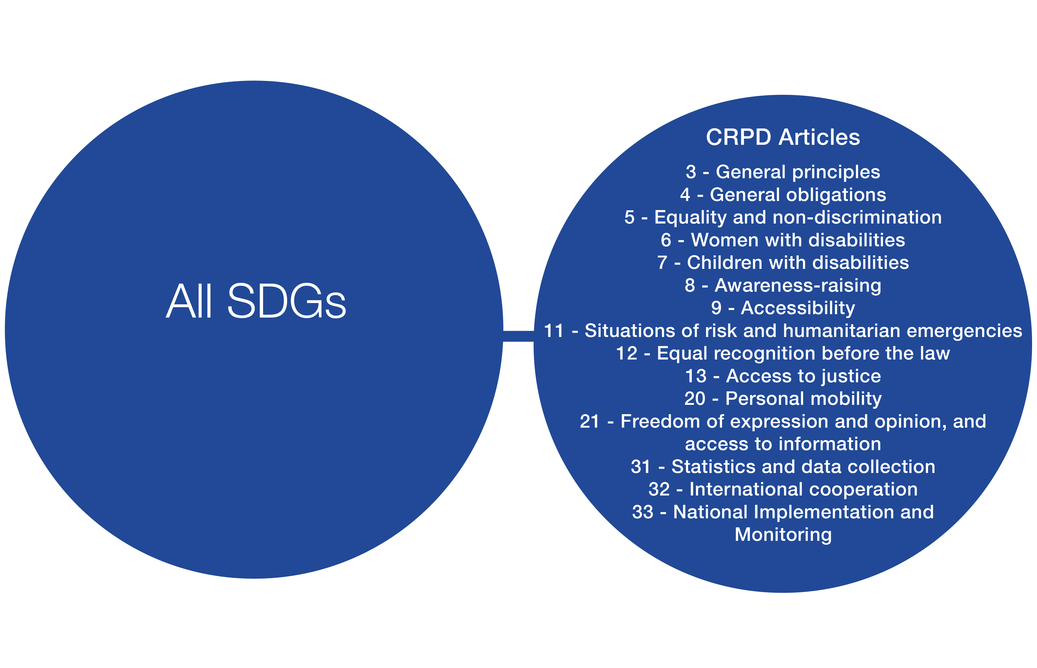
Several UN CRPD Articles are cross-cutting in nature and must always be applied and/or considered for the implementation of every Goal and target. Some examples are included below.

Slide 40
The SDGs and the UN CRPD
The following slides link individual SDGs to closely corresponding CRPD Articles
Please keep in mind that all the cross-cutting CRPD Articles are not included in the diagrams for the sake of clarity
The official corresponding CRPD Articles will have to be provided by the UN CRPD Committee and the UN Office of the High Commissioner for Human Rights
Please be advised that the below examples are illustrative and not defining of the relationship between the SDGs and the CRPD

Slide 41
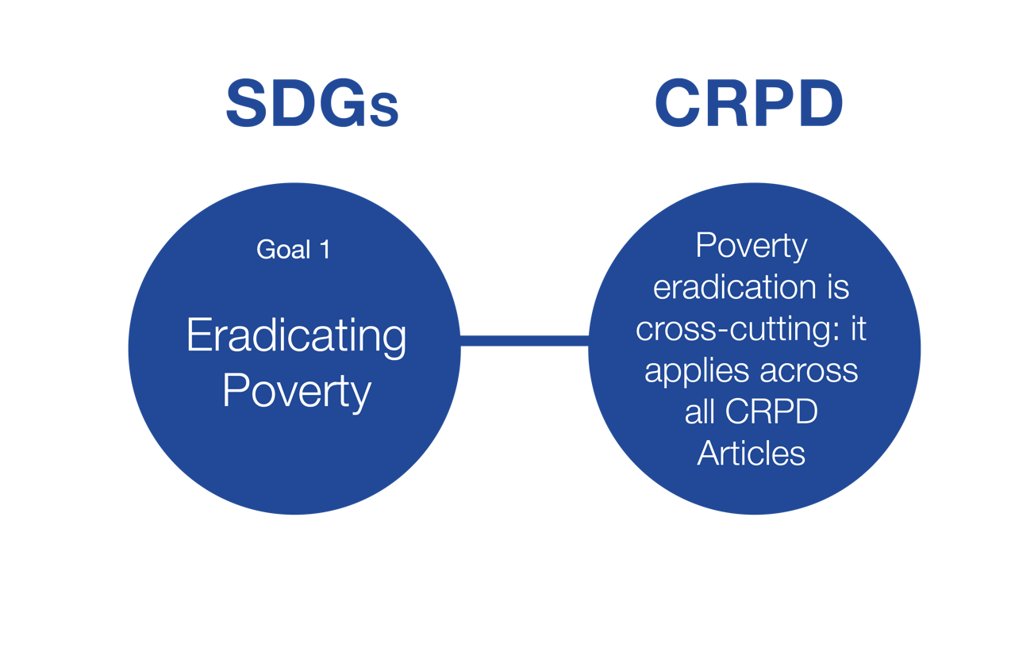
Goal 1: Eradicating Poverty

Slide 42
Goal 1: Eradicating Poverty
What it means for persons with disabilities:
  Eradicate extreme poverty for all people everywhere
  Implement social protection systems and measures for all, and achieve substantial coverage of the poor and the vulnerable
  Ensure that the poor and the vulnerable, have equal rights to
    economic resources
    access to basic services
    ownership (land, property, inheritance, natural resources)
    new technology
    financial services, including microfinance
  Build the resilience of the poor and those in vulnerable situations and reduce their exposure
When is the goal achieved for persons with disabilities?
  All are lifted out of extreme poverty, empowered, active contributors of society and enjoy equal rights

Slide 43
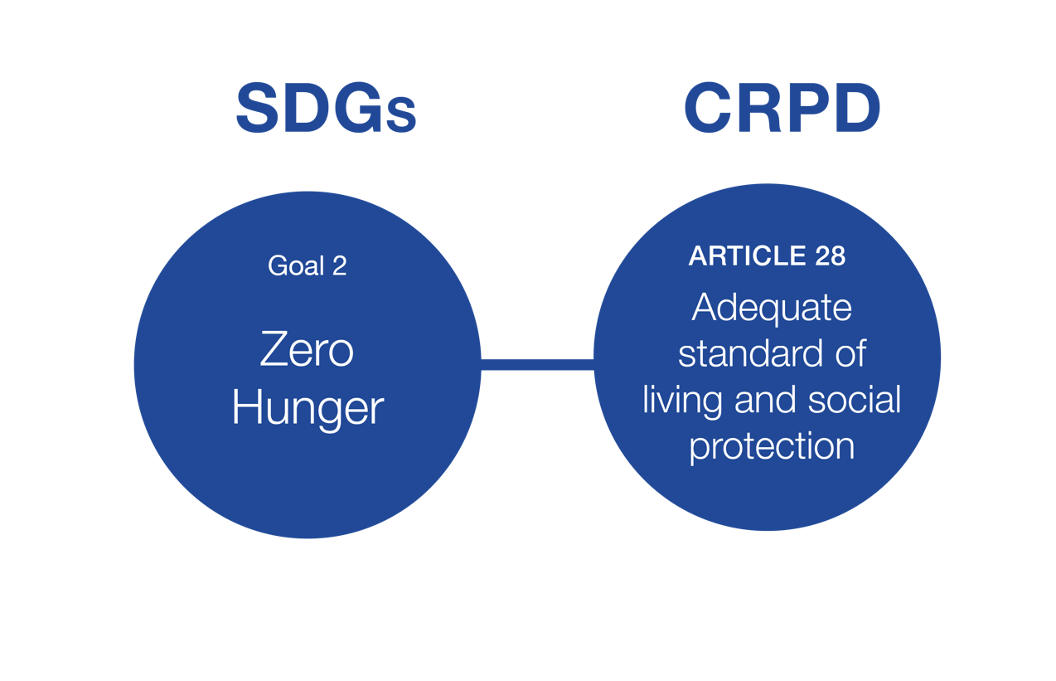
Goal 2: Zero Hunger

Slide 44
Goal 2: Zero Hunger
What it means for persons with disabilities:
  End hunger and ensure access for all people—in particular the poor and people in vulnerable situations—to safe, nutritious and sufficient food all year round
  End all forms of malnutrition
When is the goal achieved for persons with disabilities?
  Food security is realized for persons with disabilities everywhere
  Final report of the 1996 World Food Summit states that food security "exists when all people, at all times, have physical and economic access to sufficient, safe and nutritious food to meet their dietary needs and food preferences for an active and healthy life.”

Slide 45
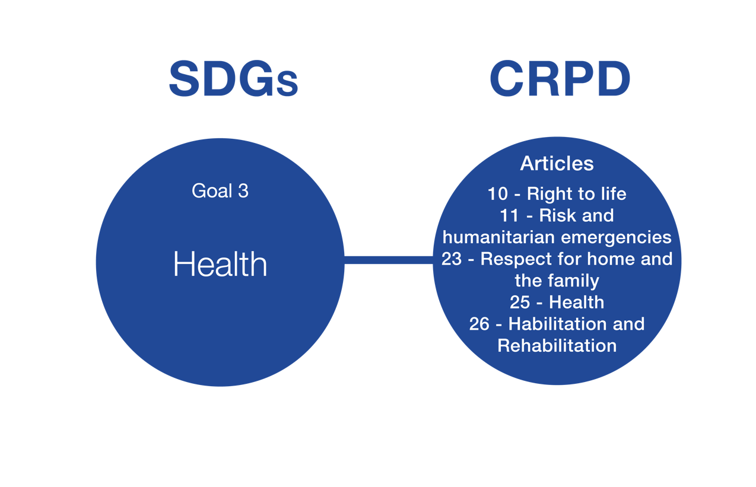
Goal 3: Health

Slide 46
Goal 3: Health
What it means for persons with disabilities:
  Achieve universal health coverage, including financial risk protection, access to quality essential health-care services and access to safe, effective, quality and affordable essential medicines and vaccines for all
  To achieve universal health coverage and access to quality health care are critical in particular reading it together with the principle “No one must be left behind” – reinforced explicitly by Art 26. of the Agenda
When is the goal achieved for persons with disabilities?
  Access to universal health coverage and health care services is realized including for health costs related to disability

Slide 47
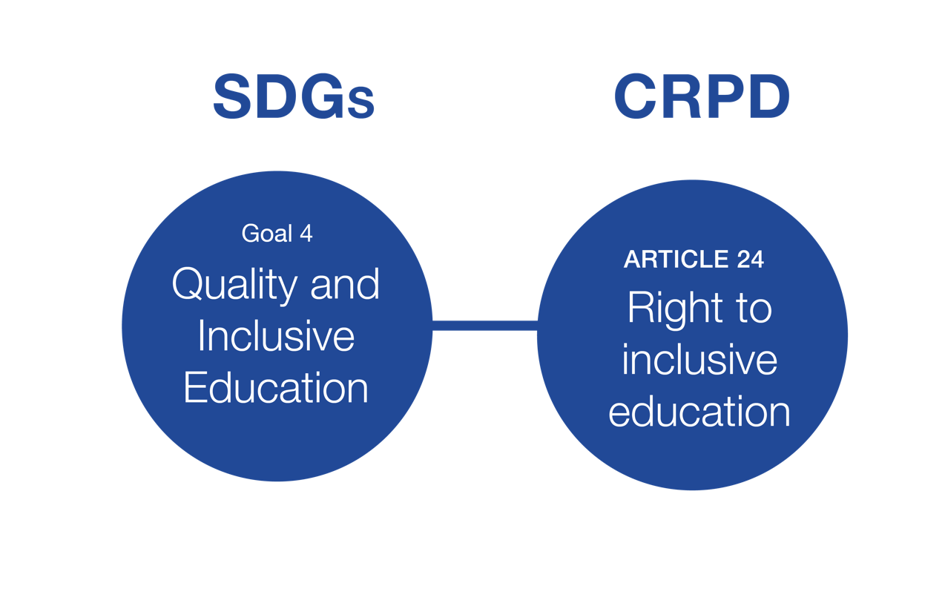
Goal 4: Quality and Inclusive Education

Slide 48
Goal 4: Quality and Inclusive Education
What it means for persons with disabilities:
  Ensure that all girls and boys:
    complete free, equitable and quality primary and secondary
    have access to quality early childhood development, care and pre-primary education
    have equal access to affordable and quality technical, vocational and tertiary education, including university
  Eliminate gender disparities in education and ensure equal access to all levels of education and vocational training for the vulnerable, including persons with disabilities
  Build and upgrade education facilities that are child, disability and gender sensitive
When is the goal achieved for persons with disabilities?
  When inclusive, accessible and quality education for children and persons with disabilities is realized at all levels (primary, secondary, tertiary, and vocational training) leading to relevant and effective learning outcomes

Slide 49
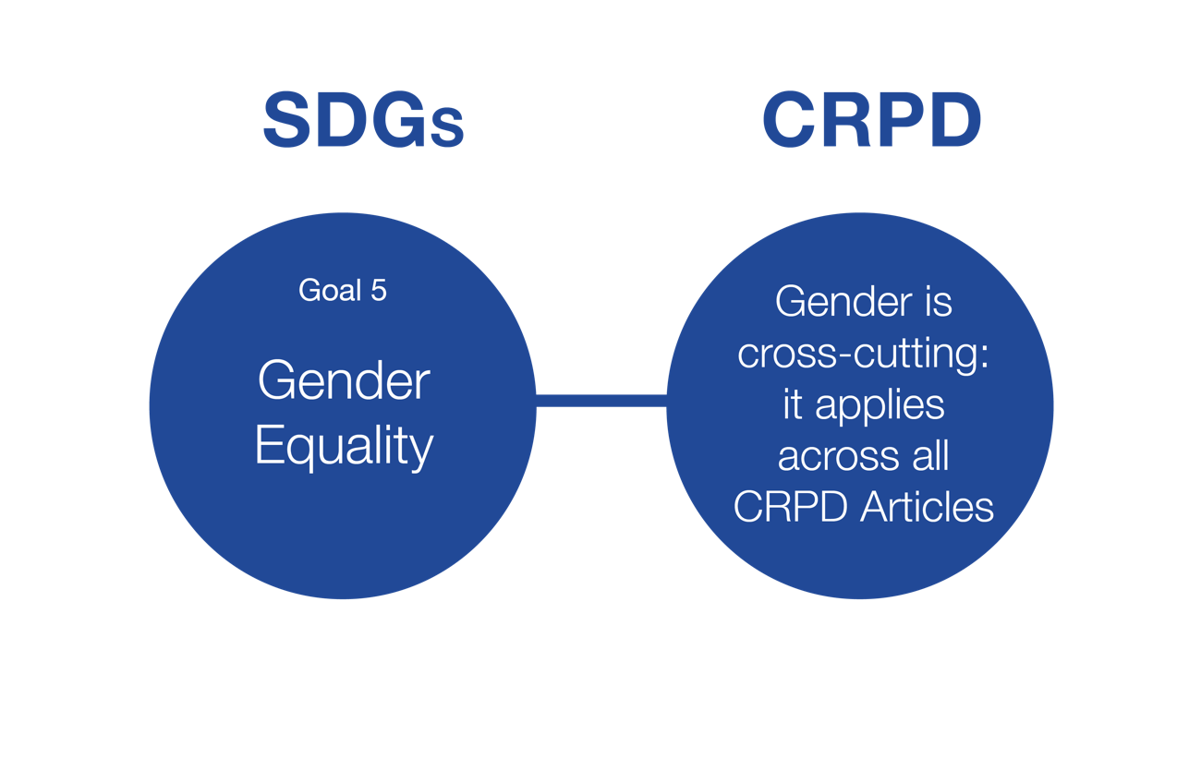
Goal 5: Gender Equality

Slide 50
Goal 5: Gender Equality
What it means for persons with disabilities:
  End all forms of discrimination against all women and girls everywhere
  Eliminate all forms of violence
  Eliminate all harmful practices, such as child, early and forced marriage and female genital mutilation
  Ensure women’s full and effective participation and equal opportunities for leadership at all levels of decision-making in political, economic and public life
  Ensure universal access to sexual and reproductive health and reproductive rights
When is the goal achieved for persons with disabilities?
  To end violence and discrimination towards girls and women with disabilities or towards women with children with disabilities, to ensure that both are not excluded from society and treated equally

Slide 51
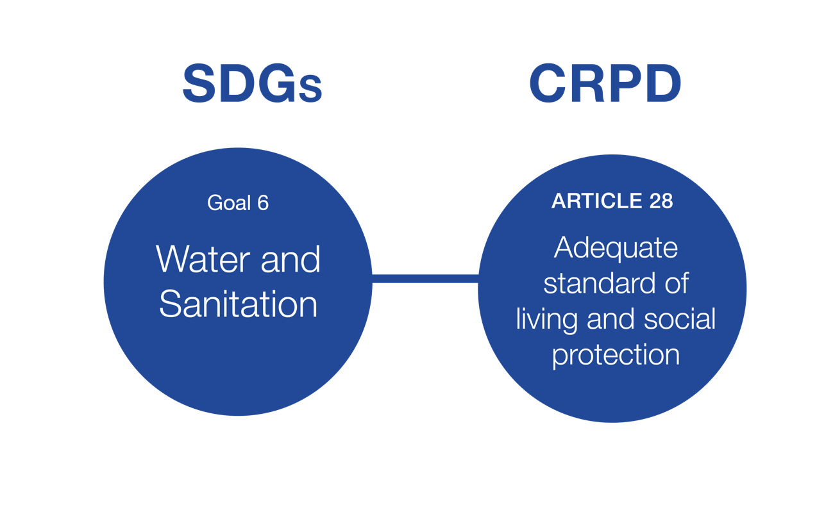
Goal 6: Water and Sanitation

Slide 52
Goal 6: Water and Sanitation
What it means for persons with disabilities:
  Achieve universal and equitable access to safe and affordable drinking water for all
  Achieve access to adequate and equitable sanitation and hygiene for all and end open defecation, paying special attention to the needs of women and girls and those in vulnerable situations
When is the goal achieved for persons with disabilities?
  Access to safe drinking water and sanitation is provided

Slide 53
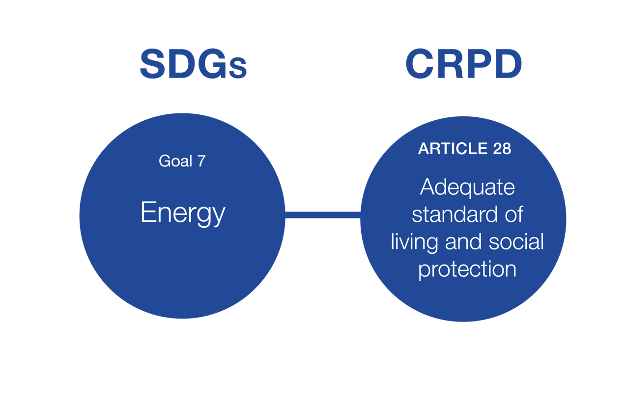
Goal 7: Energy

Slide 54
Goal 7: Energy
What it means for persons with disabilities:
  Ensure universal access to affordable, reliable and modern energy services for all
When is the goal achieved for persons with disabilities?
  When households with persons with disabilities have access to electricity

Slide 55
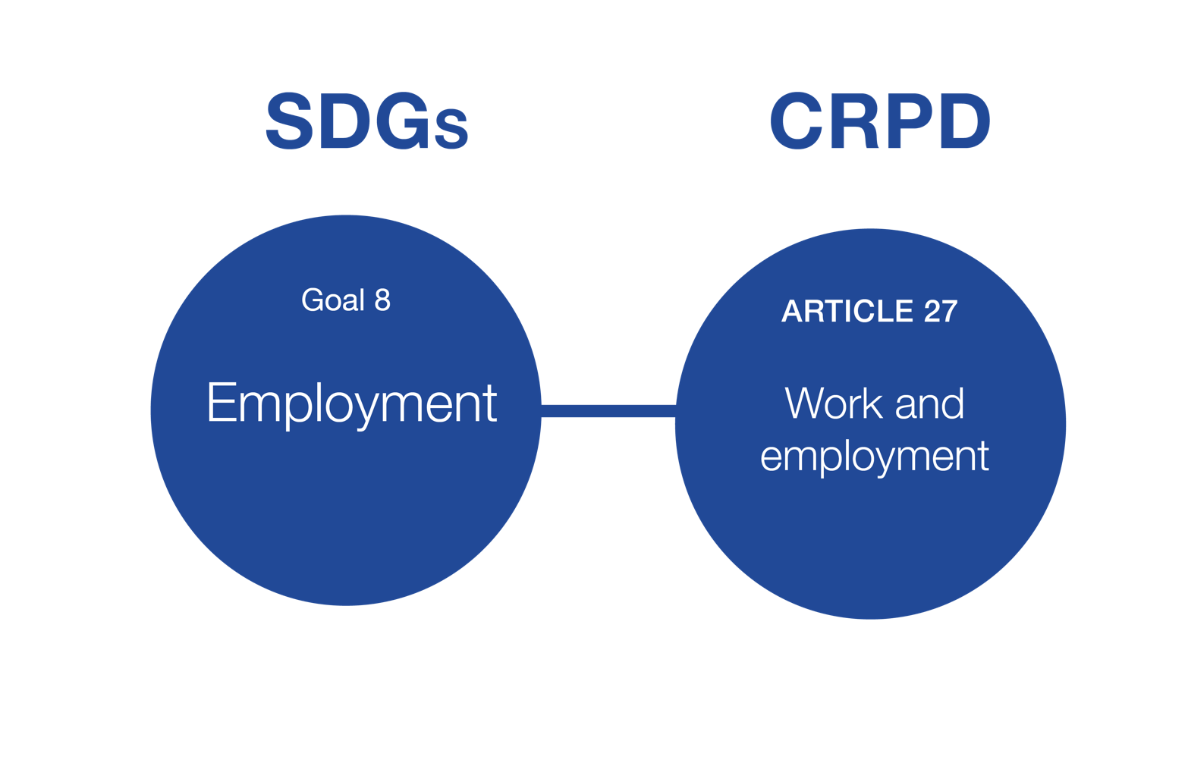
Goal 8: Employment

Slide 56
Goal 8: Employment
What it means for persons with disabilities:
  Promote development-oriented policies that support productive activities, decent job creation, entrepreneurship, creativity and innovation, and encourage the formalization and growth of micro-, small- and medium-sized enterprises, including through access to financial services
  Achieve full and productive employment and decent work for all women and men, including for young people and persons with disabilities, and equal pay for work of equal value
When is the goal achieved for persons with disabilities?
  The expansion of anti-discrimination provisions in labour and labour-related laws
  The realization for reasonable accommodation and creating more inclusive mainstream initiatives to promote full and productive employment for persons with disabilities
  Access to training and vocational education courses
  Access to bank loans and micro-finances to start-up businesses

Slide 57
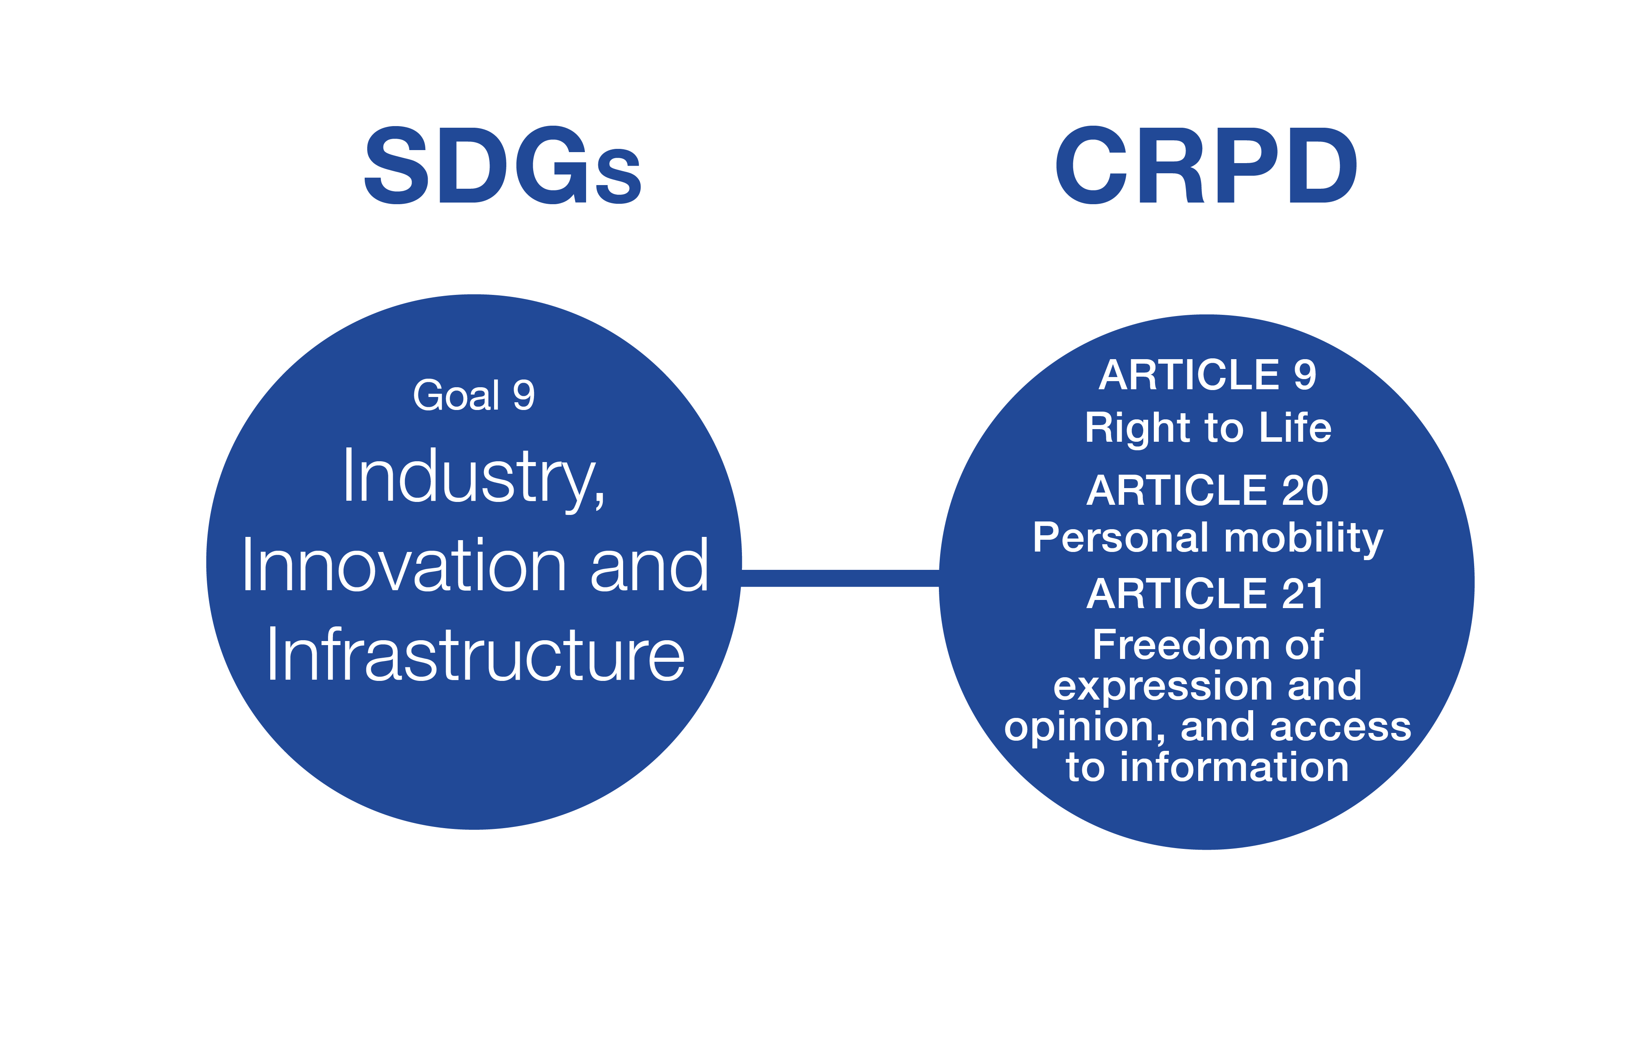
Goal 9: Industry, Innovation and Infrastructure

Slide 58
Goal 9: Industry, Innovation and Infrastructure
What it means for persons with disabilities:
  Develop quality, reliable, sustainable and resilient infrastructure, including regional and trans-border infrastructure, to support economic development and human well-being, with a focus on affordable and equitable access for all
  Increase the access of small-scale industrial and other enterprises, in particular in developing countries, to financial services, including affordable credit, and their integration into value chains and markets
When is the goal achieved for persons with disabilities?
  Realize access to credit and establish enabling public policy environments to enhance possibilities for persons with disabilities.
  Ensure that built, transport and communications infrastructure and ICT are inclusive and accessible to persons with disabilities
  Provide increased access to public services to promote full and equal inclusion into society through ICTs for persons with disabilities

Slide 59
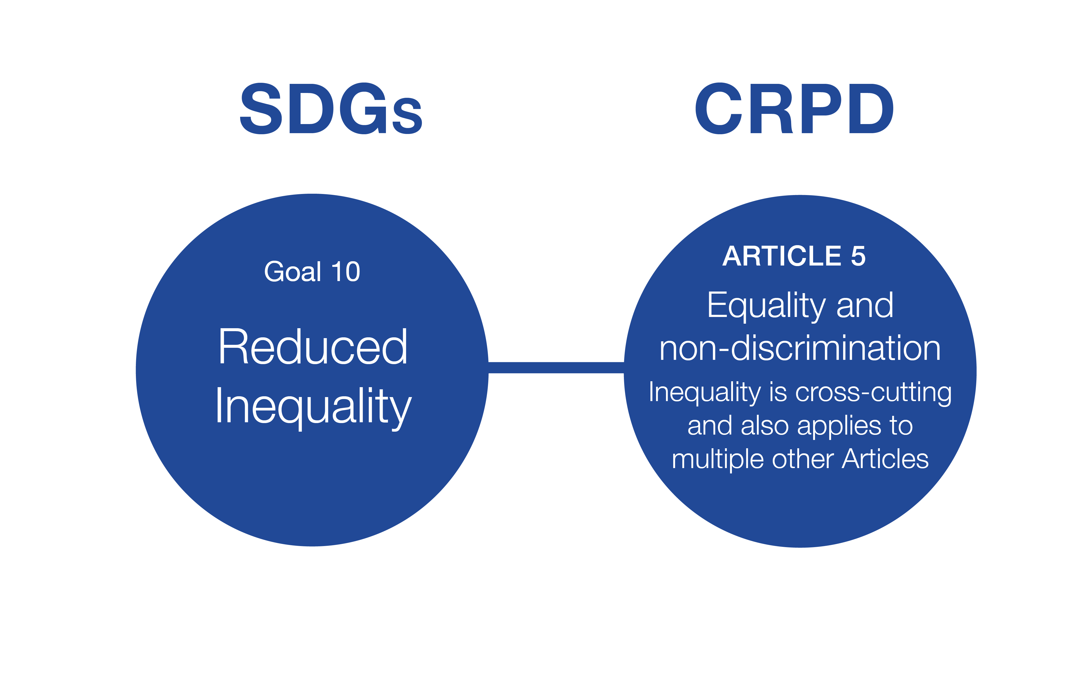
Goal 10: Reduced Inequality

Slide 60
Goal 10: Reduced Inequality
What it means for persons with disabilities:
  Empower and promote the social, economic and political inclusion of all, irrespective of age, sex, disability, race, ethnicity, origin, religion or economic or other status
  Ensure equal opportunity and reduce inequalities of outcome, including by eliminating discriminatory laws, policies and practices and promoting appropriate legislation, policies and action in this regard
  Adopt policies, especially fiscal, wage and social protection policies, and progressively achieve greater equality
When is the goal achieved for persons with disabilities?
  Persons with disabilities participate equally in political activities
  All national laws and policies are disability inclusive and seek to eliminate discrimination and provide for reasonable accommodation
  Persons with disabilities have equal access to all social, cultural, economic and political opportunities and can access all services on equal basis with others
  Achieve social protection and essential public services for persons with disabilities

Slide 61
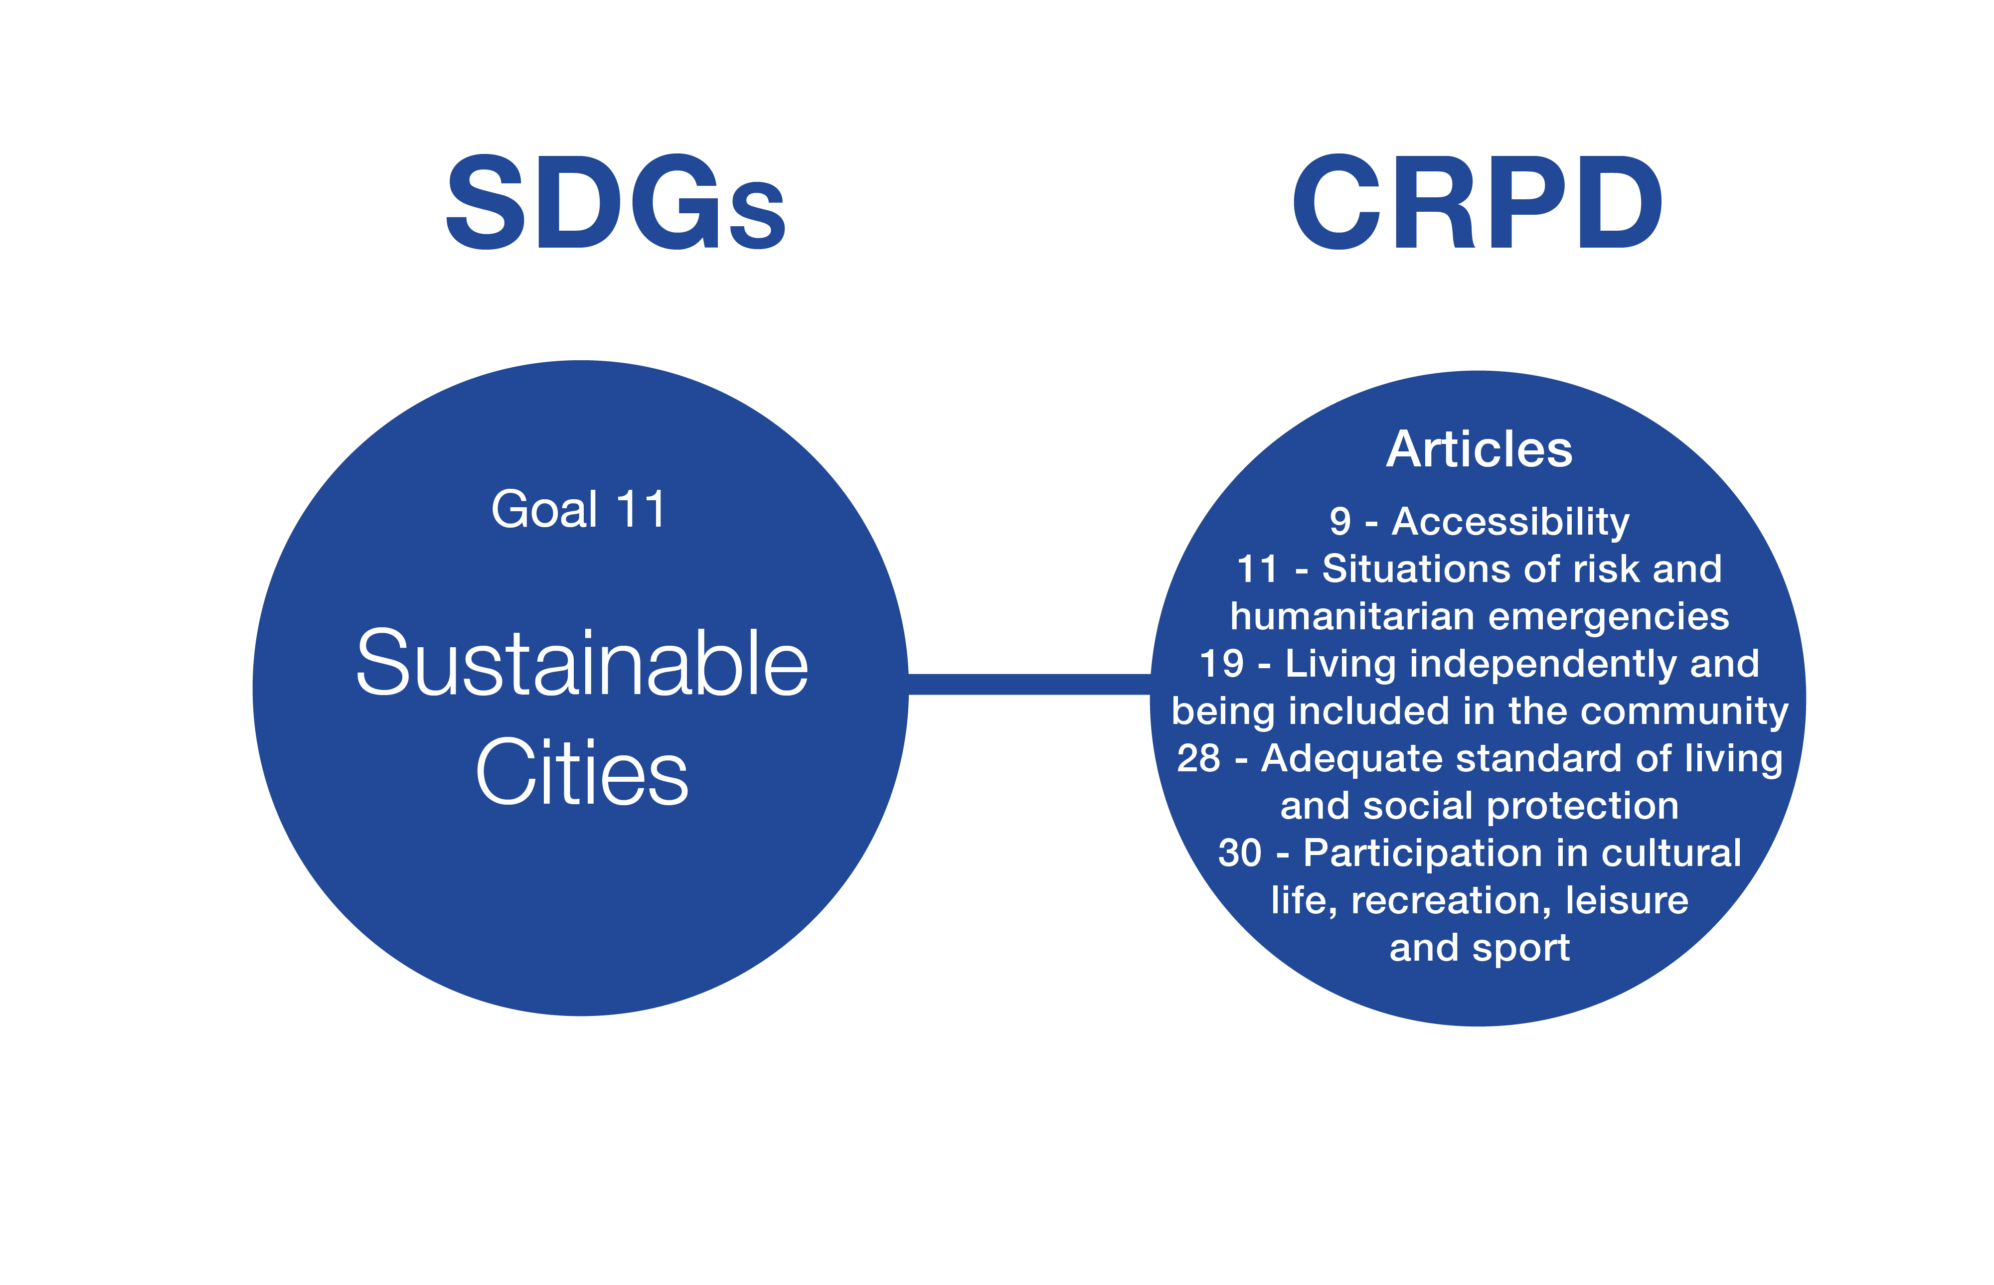
Goal 11: Sustainable Cities

Slide 62
Goal 11: Sustainable Cities
What it means for persons with disabilities:
  Ensure access for all to adequate, safe and affordable housing and basic services and upgrade slums
  Provide access to safe, affordable, accessible and sustainable transport systems for all, improving road safety, notably by expanding public transport, with special attention to the needs of those in vulnerable situations, women, children, persons with disabilities and older persons
  Reduce the number of deaths caused by disasters, including water-related disasters, with a focus on protecting the poor and people in vulnerable situations
  Provide universal access to safe, inclusive and accessible, green and public spaces, in particular for women and children, older persons and persons with disabilities
When is the goal achieved for persons with disabilities?
  Cities and human settlements are livable, inclusive, accessible with universal design principles that can lead to a safer, more resilient world for all.
  There is inclusion and meaningful participation of persons with disabilities in all disaster risk reduction and disaster risk management programmes (Sendai Framework and Dhaka Declaration)

Slide 63
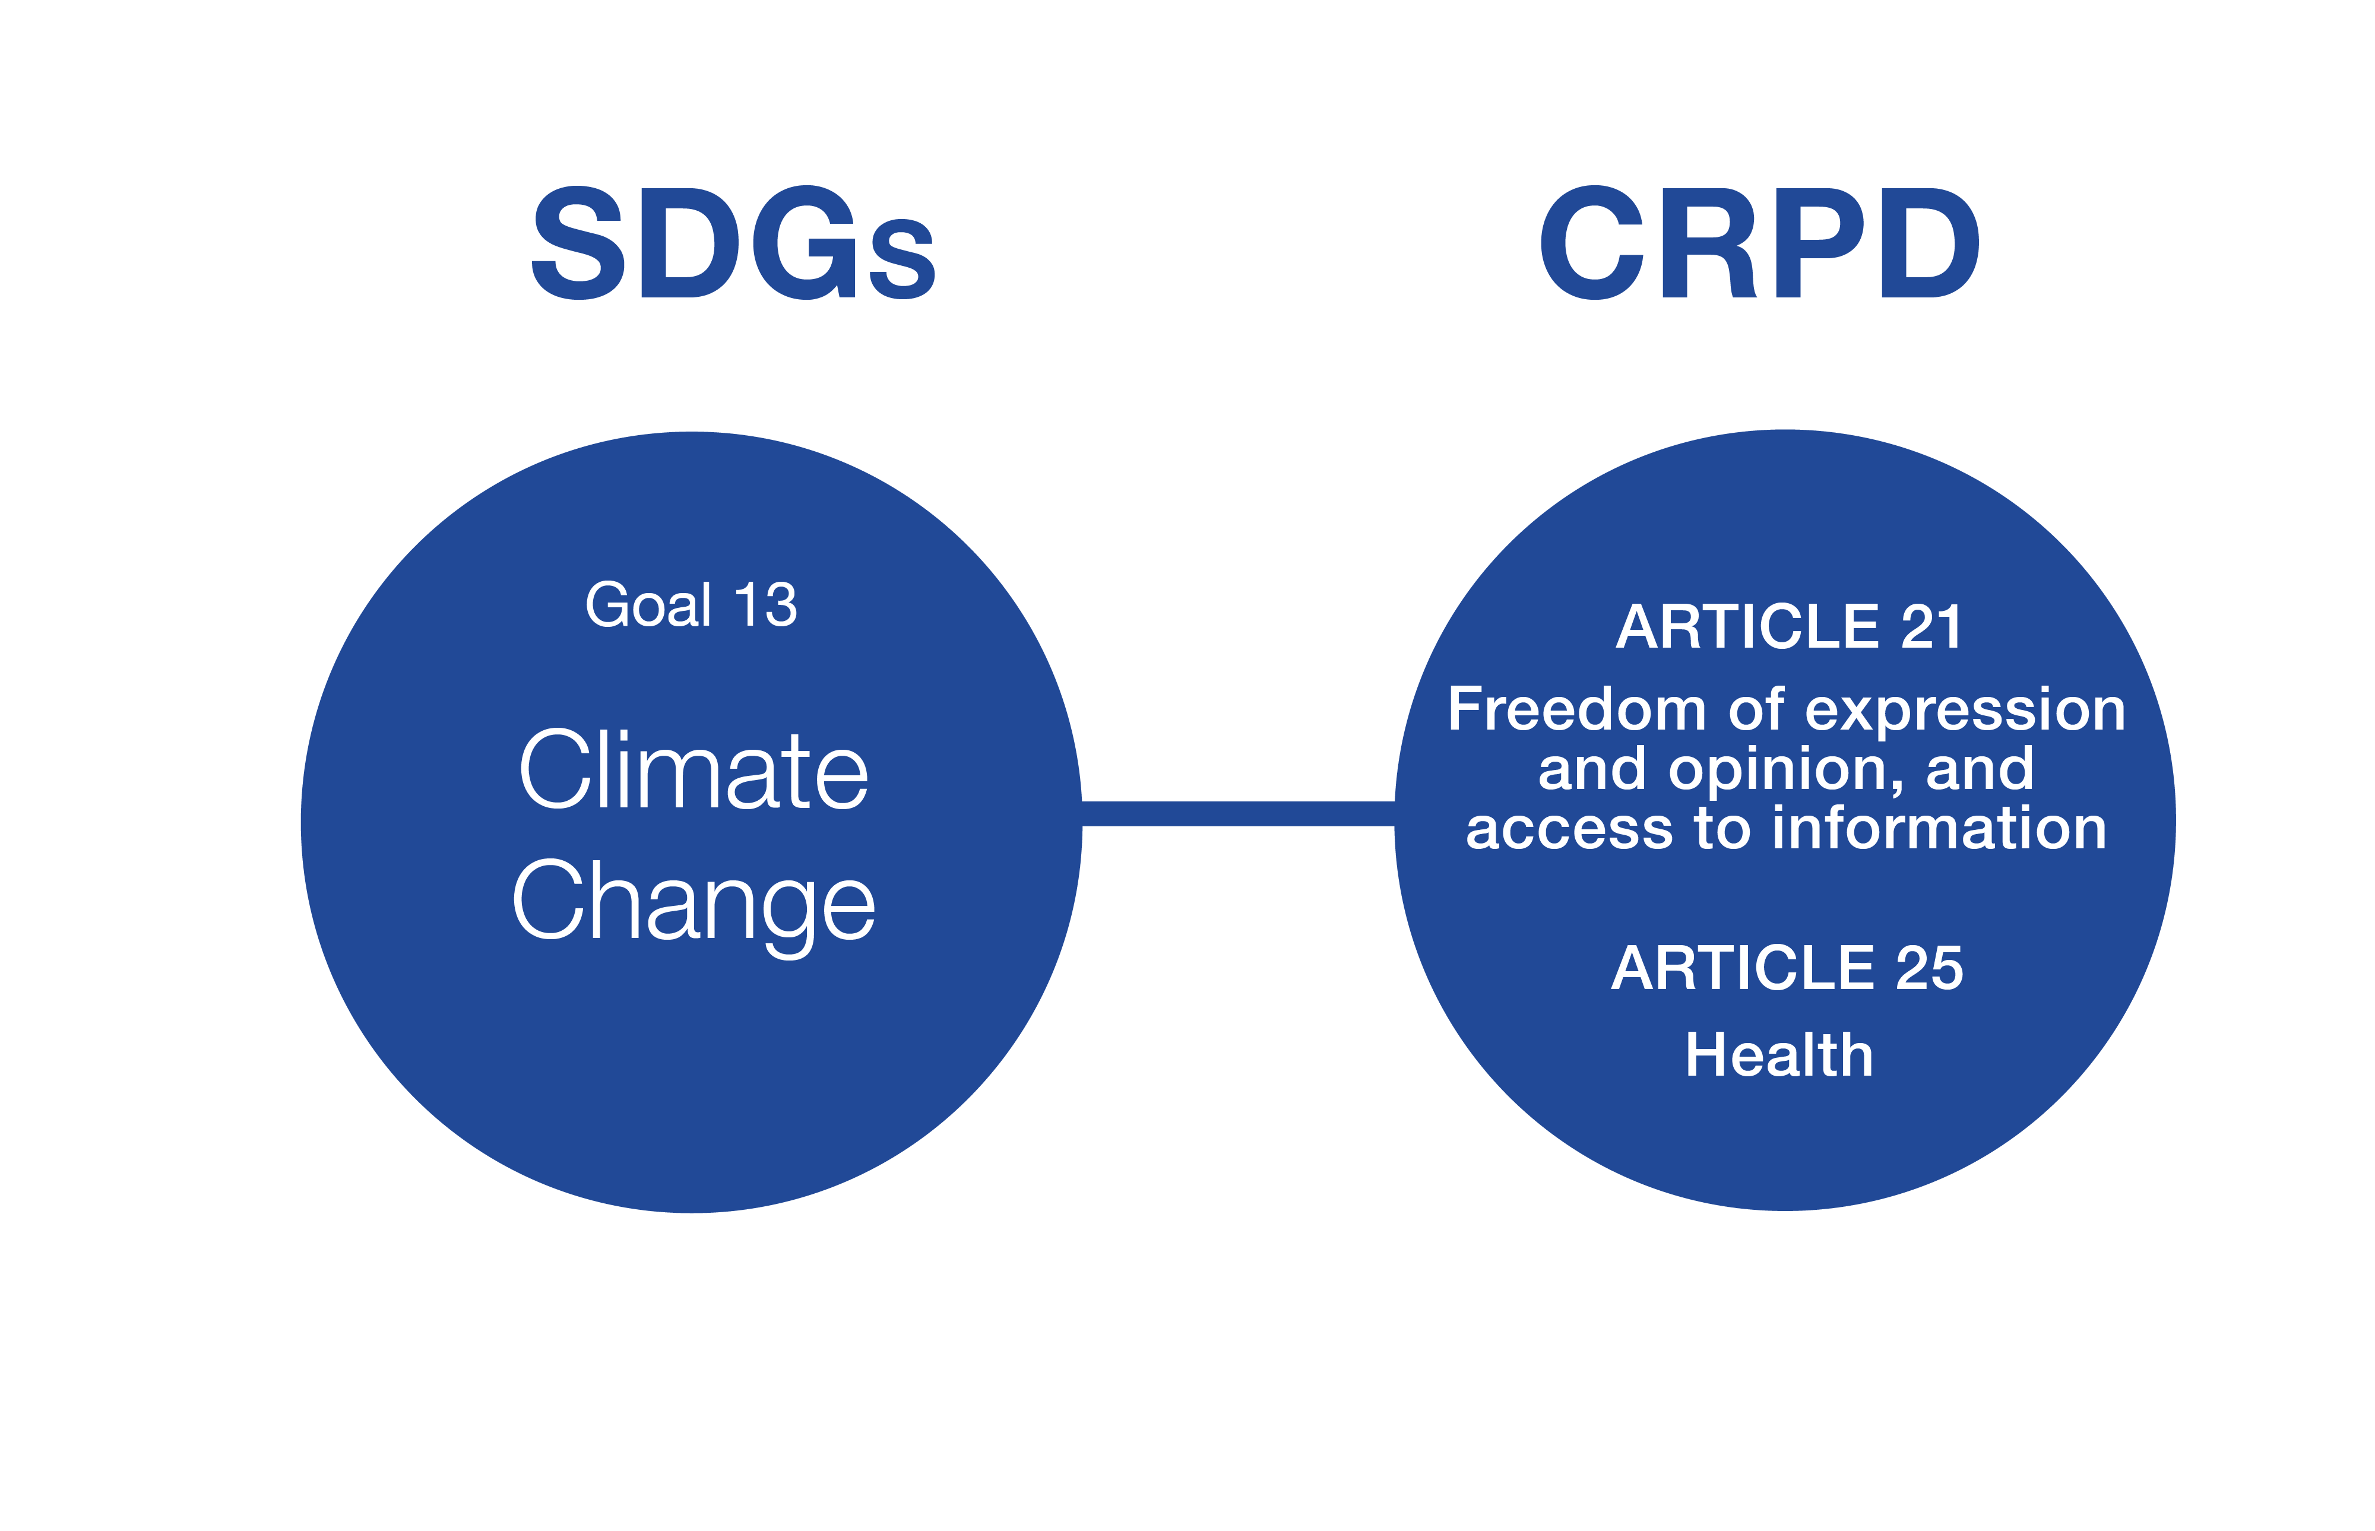
Goal 13: Climate Change

Slide 64
Goal 13: Climate Change
What it means for persons with disabilities:
  Strengthen resilience and adaptive capacity to climate-related hazards and natural disasters in all countries
  Integrate climate change measures into national policies, strategies and planning
  Improve education, awareness-raising and human and institutional capacity on climate change mitigation, adaptation, impact reduction and early warning
  Promote mechanisms for raising capacity for effective climate change-related planning and management in least developed countries and small island developing States, including focusing on women, youth and local and marginalized communities
When is the goal achieved for persons with disabilities?
Provision of food, water and shelter security for people with disabilities and their families
Ensuring that people with disabilities are front and centre in seeking to create awareness, understanding and solutions.

Slide 65
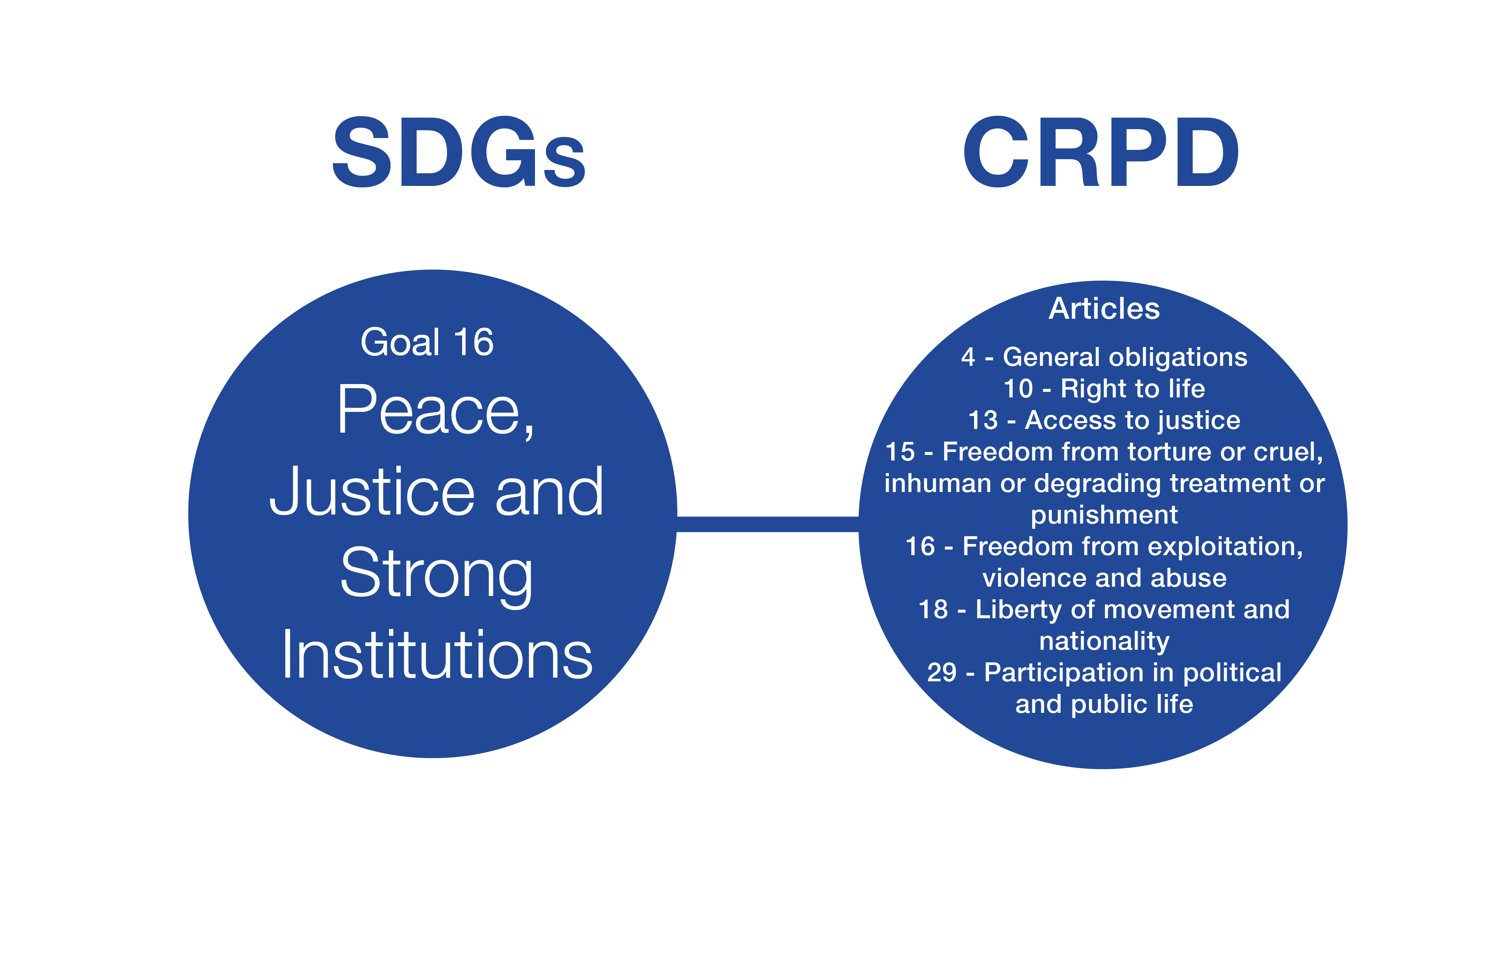
Goal 16: Peace, Justice and Strong Institutions

Slide 66
Goal 16: Peace, Justice and Strong Institutions
What it means for persons with disabilities:
  Significantly reduce all forms of violence and related death rates everywhere
  End abuse, exploitation, trafficking and all forms of violence against and torture of children
  Promote the rule of law at the national and international levels and ensure equal access to justice for all
  Develop effective, accountable and transparent institutions at all levels
  Ensure responsive, inclusive, participatory and representative decision-making at all levels
  Provide legal identity for all, including birth registration
  Ensure public access to information and protect fundamental freedoms, in accordance with national legislation and international agreements
  Promote and enforce non-discriminatory laws and policies for sustainable development

Slide 67
Goal 16: Peace, Justice and Strong Institutions
When is the goal achieved for persons with disabilities?
  Persons with disabilities are included in public services, are represented in key decision-making bodies and processes. Significant reduction of instances that persons with disabilities are subjected to violence and discrimination. All persons with disabilities must be registered at birth.
  End to forced sterilisations of persons with disabilities
  Justice institutions are accessible to persons with disabilities to protect and defend their rights and participate in justice system [including as judges, administrators, jurors etc]
  Justice system actors understand and implement disability rights consistent with CRPD

Slide 68
Means of Implementation (MoI) and the Global Partnership: Background
MoI was addressed throughout the Agenda:
  Declaration Chapter has a section on MoI
  SDGs, under each Goal, and a stand alone Goal 17
  Chapter on MoI
This was the most controversial and the most political aspect of the Agenda
While the developing countries argued for the need of strengthened, detailed, explicit and external financial commitments, developed countries argued that the complexity of the Agenda required significant change in international and domestic financial thinking, beyond existing financial systems

Slide 69
Means of Implementation and the Global Partnership
The chapter on MoI deals with the means required to implement the Goals and targets, which include the mobilization of:
  financial resources (international financing, domestic resources mobilization, debt relief, trade)
  domestic and international capacity-building
  transfer of technologies
  private sector, civil society organizations and philanthropic organizations
Mobilization of resources can be achieved by revitalized Global Partnership:
  bringing together Governments, the private sector, civil society, the United Nations system and other actors, including the poorest and most vulnerable

Slide 70
Addis Ababa Action Agenda
The Addis Ababa Action Agenda is the outcome of the Third International Conference on Financing for Development which is an integral part of the 2030 Agenda.
The Addis Ababa Action Agenda supports, complements and helps to contextualize the 2030 Agenda’s means of implementation in depth.
Persons with disabilities are mentioned in the following areas of the Addis Ababa Action Agenda: social protection, employment, education, infrastructure, technology and data.

Slide 71
Follow-up and Review: Overview
The Agenda’s final chapter outlines its aims:
  to track progress in implementation and
  to ensure that no one is left behind
The follow-up and review mechanism (paragraphs 47 & 77) is the litmus test of the Agenda, it will only work with:
  Vision: robust, voluntary, effective, participatory, transparent and integrated follow-up and review framework is realized
  Inclusive partnerships: effective international cooperation and exchanges of best practices and mutual learning
The follow-up and review mechanism doesn't make States accountable but once again ensures national ownership. However, as a political compromise, it does promote their accountability to their citizens, including persons with disabilities

Slide 72
Persons with Disabilities and Accountability
“Persons with disabilities were instrumental in creating this transformational roadmap to a better future. Now the hard work of real change lies directly ahead. Persons with disabilities must be leaders, guiding the world towards achieving these goals for everyone. This journey demands our persistent and unwavering duty to hold our governments accountable to their own commitments. Our full engagement in the follow-up and review mechanism is fundamental. We cannot afford to be left behind again.”
  - Maryanne Diamond, Chair of the International Disability Alliance, 2015

Slide 73
Persons with Disabilities and Accountability
The participation of persons with disabilities in the follow-up and review mechanism is critical and will serve as a litmus test to whether the 2030 Agenda fulfilled what the MDGs have failed for persons with disabilities
Persons with disabilities must engage with their governments and monitor that the 2030 Agenda is implemented for them and with them.

Slide 74
Follow-up and Review: Principles
Voluntary: National ownership and country-led
Robust: applies universally across all countries and all three dimension of sustainable development (social, economic, environmental)
Effective: aiming to identification of solutions and best practices and promote the coordination and effectiveness of the international development system
Participatory: Be open, inclusive, participatory and transparent for all people
Integrated: People-centred, gender-sensitive, respect human rights + focus on the poorest, most vulnerable and those furthest behind
Efficient: Build on existing platforms and processes build and respond to national circumstances, capacities, needs and priorities
Data-driven: Based on evidence – global indicators, enhanced capacity-building on data collection
Multilateral: Active support of the United Nations system and other multilateral institutions

Slide 75
Levels of the Follow-up and Review Framework
National/sub-national levels: governments conduct regular and inclusive reviews of progress; the review mechanism will differ in every country, the inclusion of stakeholders is encouraged in the 2030 Agenda
Regional/Sub-regional levels: governments undertake peer learning, including through voluntary reviews, sharing of best practices and discussion of shared targets and cooperation each region will designate a body or organisaton to achieve this
Global level: The High-level Political Forum (HLPF) undertakes the global follow-up and review of governments’ implementation of the SDGs

Slide 76
Follow-up and Review: participation of persons with disabilities
Global Advocacy
Participate in the global coordination mechanism established for persons with disabilities
Contribute to annual, thematic and national reviews
Regional Advocacy
Share knowledge
Participate in peer review
Form and develop regional collaboration and projects
National Advocacy
Prepare parallel and shadow reports
Provide expert knowledge and engagement
Participate in government-led consultations
Partner with civil society, academia, stakeholders and UN agencies

Slide 77
High-Level Political Forum (HLPF): Global Level
The 2012 UN Conference on Sustainable Development, or ‘Rio+20’, produced “The Future We Want” agreement, establishing the HLPF to replace the Commission on Sustainable Development
In 2013 the HLPF working methods were defined by Member States and adopted by the UN General Assembly
HLPF (made up of all UN Member States) meets at the United Nations in New York:
  Under the Economic and Social Council - annually
  Under the General Assembly – every four years

Slide 78
High-Level Political Forum (HLPF): Global Level
Reason for establishing it:
  To improve and make a more effective institutional framework for sustainable development
  To promote synergies and coherence within the UN system
  To mandate the highest level of implementation monitoring
  To provide a forum for open, transparent, participative and internationally comparable reviews and proposals (although not a legally binding accountability mechanism, the global level review provides opportunities for high profile attention)

Slide 79
HLPF: Roles
Facilitate sharing of experiences
Provide political leadership, guidance and recommendations
Promote system-wide coherence
Coordinate sustainable development policies
Assess progress, challenges and emerging issues

Slide 80
HLPF: Roles
The HLPF is informed by:
  Annual Progress Report on the Sustainable Development Goals to be prepared by the Secretary-General together with UN system and global indicators
  Global Sustainable Development Report (is about science-policy interface and could provide a strong evidence-based instrument to support policymakers)
  ECOSOC consultation
  Stakeholder Consultations

Slide 81
HLPF: Types of reviews
Regular reviews by the HLPF of countries:
  Voluntary, State-led, involving ministerial and other relevant high-level participants
  Universally: for both developed and developing countries
  Provide a platform for partnerships, including through the participation of stakeholders
  Supported by reporting also of relevant United Nations entities and other stakeholders, including civil society and the private sector

Slide 82
HLPF: Types of reviews
Thematic reviews, including cross-cutting issues, by the HLPF of all countries by theme:
  On progress achieved in SDGs implementation and on cross-cutting issues
  Supported by reviews by the functional commissions of the ECOSOC and other intergovernmental bodies and forums
  Engagement of stakeholders and feed-back from them
    providing position papers
    contributing to reports
    speaking roles
    (see following slide for details)

Slide 83
HLPF: Stakeholder Engagement
The HLPF is composed of Member States, but is also open to relevant stakeholders, including persons with disabilities.
In order to make better use of their expertise, the UN General Assembly has mandated stakeholders - including persons with disabilities:
  “To attend all official meetings of the forum”
  “To have access to all official information and documents”
  “To intervene in official meetings”
  “To submit documents and present written and oral contributions”
  “To make recommendations”
  “To organize side events and round tables, in cooperation with Member States and the Secretariat”
This means the HLPF is the highest forum to raise any issues about SDG implementation related to persons with disabilities

Slide 84
Statistics and data collection
“…Quality, accessible, timely and reliable disaggregated data will be needed to help with the measurement of progress and to ensure that no one is left behind. Such data is key to decision making. Data and information from existing reporting mechanisms should be used where possible…”
- 2030 Agenda, pargraph 48
It is important to collect data which measures the progress of SDG implementation for persons with disabilities. Persons with disabilities must be both active users and contributors to the data concerning them, as in line with the UN CRPD.

Slide 85
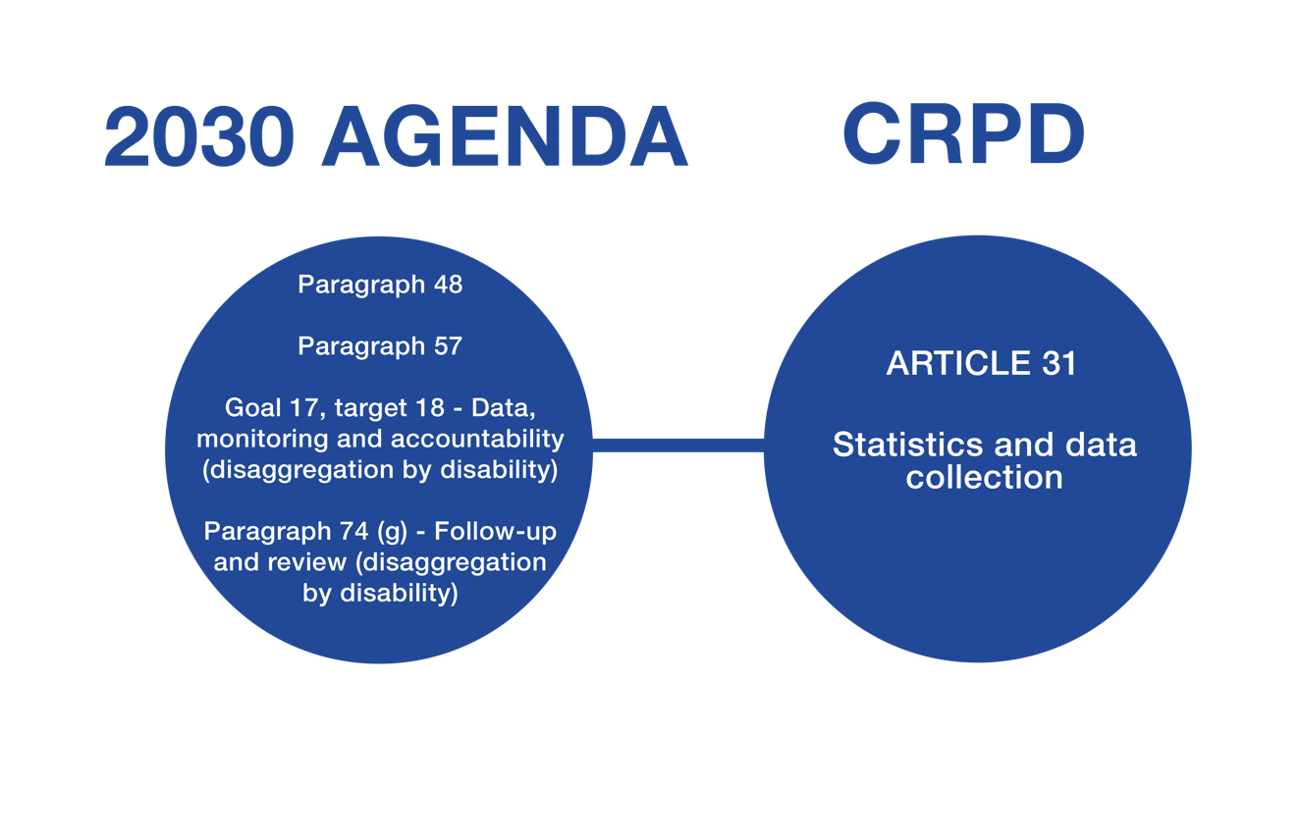
Statistics and data collection

Slide 86
Indicator Framework
Although the 2030 Agenda references it, the global indicator framework is a separate process.
The global framework was developed by statistical experts and will require approval from the UN Statistical Commission in March 2016, agreement by the Economic and Social Council, and adoption by the UN General Assembly.
Global indicators will measure the progress made in implementing the SDGs. Such data is key to decision-making and to help with the measurement of progress, making international comparisons and ensuring that no one is left behind.
Data and information from existing national and international reporting mechanisms should be used where possible. In order to enable data collection, statistical capacities require strengthening.
We need very robust data sets on disability to help monitor progress. It is important to measure whether people with disability are really being left behind or whether they are progressing equally with others.

Slide 87
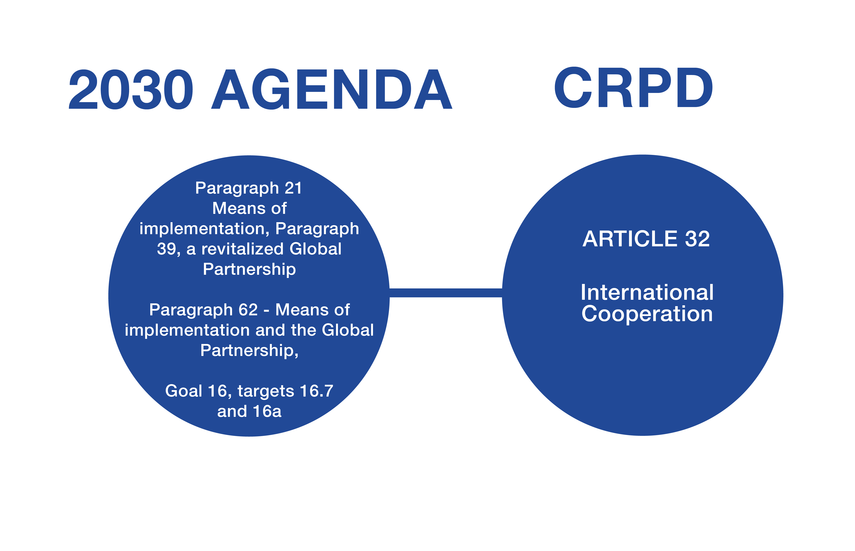
International Cooperation
It is important to recognise that international cooperation activities need to be inclusive of and accessible to persons with disabilities to ensure the full realization of the objectives and purpose of the CRPD.

Slide 88
Thank you

Slide 89
List of references
2030 Agenda sustainabledevelopment.un.org/post2015/transformingourworld
Funding For Development
www.un.org/esa/ffd/ffd3
HLPF Resolution
https://sustainabledevelopment.un.org/hlpf
Beijing Platform for Action
http://beijing20.unwomen.org/en/about
DRR Outcome
http://www.unisdr.org/we/coordinate/sendai-framework

Slide 90



Contact
@iddcconsortium
/IDDCinfo
IDDCconsortium.net
info@iddcconsortium.net
@IDA_CRPD_Forum
/InternationalDisabilityAllianceIDA
InternationalDisabilityAlliance.org
info@ida-secretariat.org
Notes:
All sections are relevant and important, yet the main focus, particularly regarding implementation, seems to center on the sustainable development goals (SDGs).

