Slide 1
“Countries in special situations: perspectives from LDCs, LLDCs and MICs” Including Persons with Disabilities
By ALZOUMA MAIGA IDRISS

Slide 2
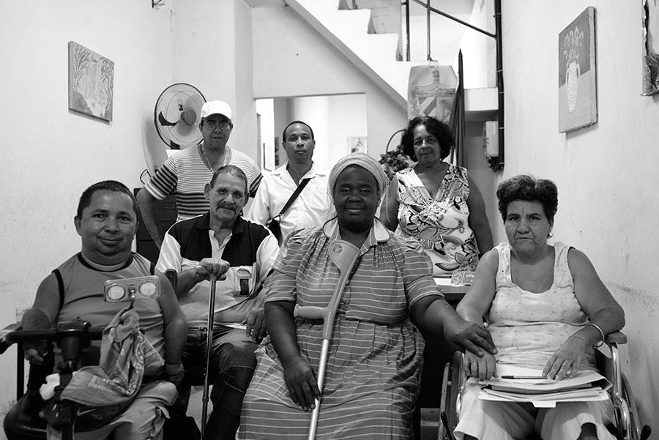
Introduction
Persons with Disabilities comprise of 1billion people globally
Majority lives in Least Developed Countries (LDCs), Landlocked Developing States (LLDCs) and Middle-Income Countries (MICs)

Slide 3
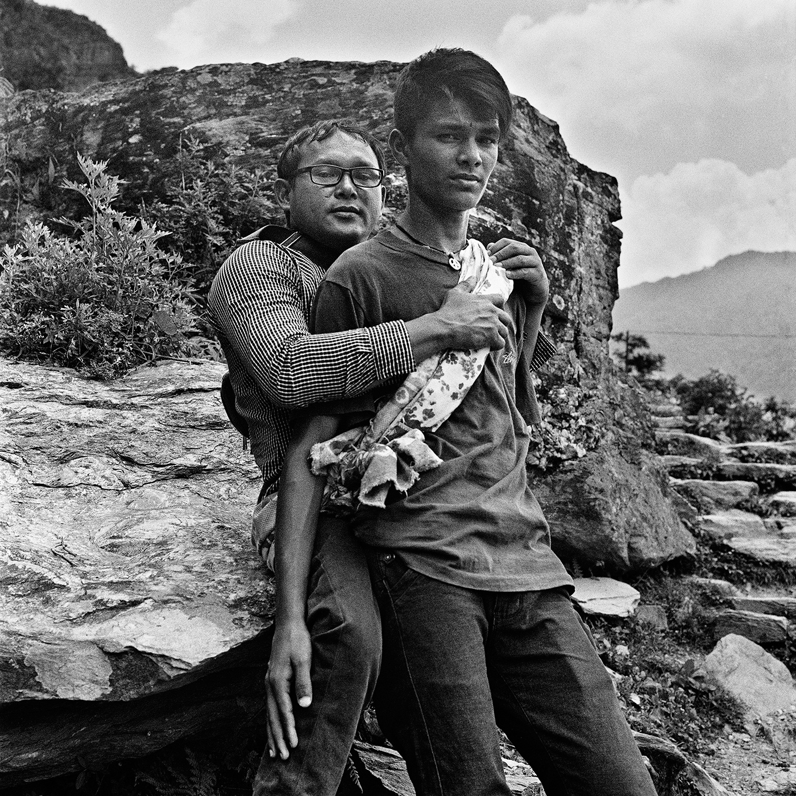
Challenges
Least Developed Countries, Landlocked Developing States and Middle-Income Countries, conflict and post-conflict countries face numerous challenges,
BUT
the overall social crisis creates a more significant burden on persons with disabilities as one of the most marginalized groups in society. one of the most marginalized groups in society.

Slide 4
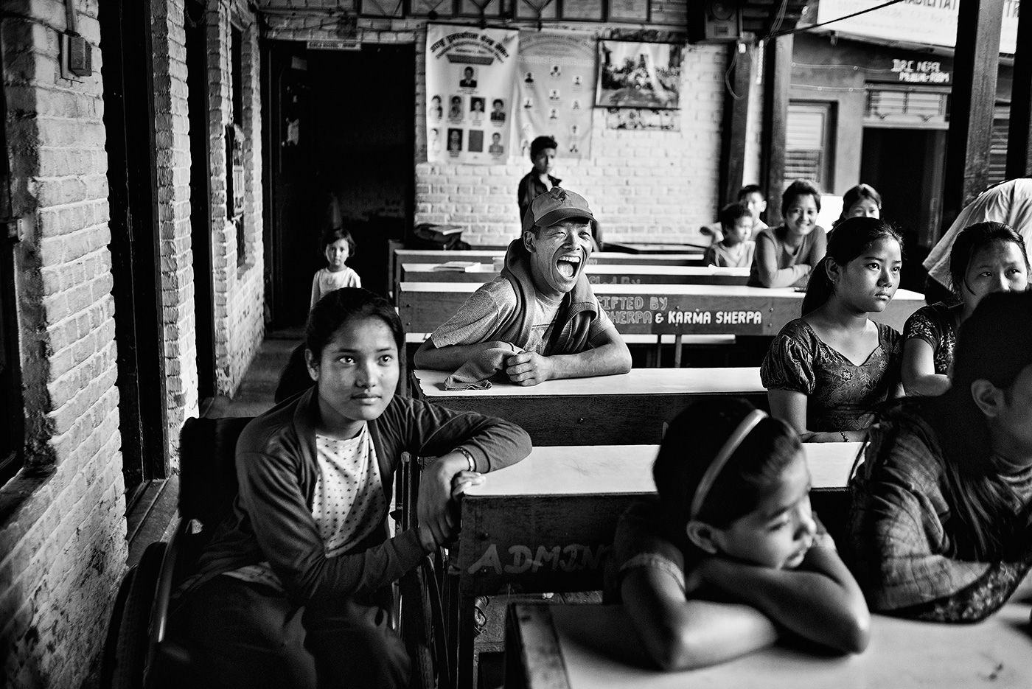
Prospects
realizing the Istanbul Program of Action for LDCs and SDGs realizing the Istanbul Program of Action for LDCs and SDGs
Should benefit all persons, particularly children, youth, women, older persons, persons with disabilities, indigenous peoples, and migrants to jointly create a peaceful and prosperous society

Slide 5
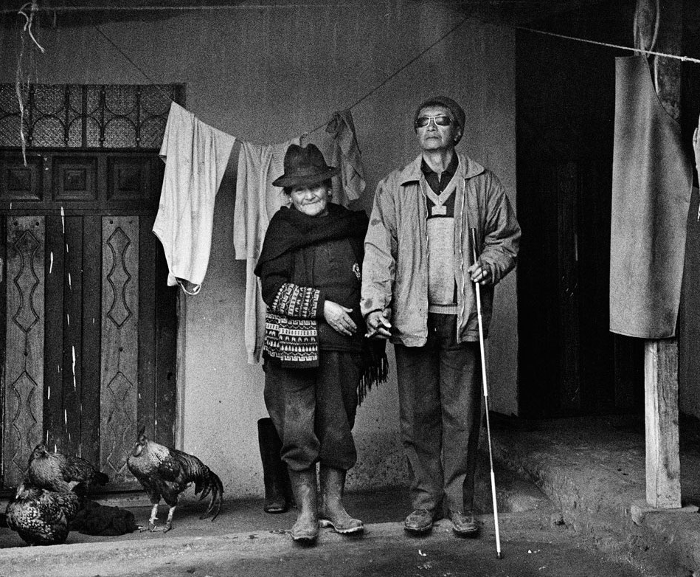
Recommendations
Develop and adopt a strong human rights approach on mobilizing resources for the implementation of the 2030 Agenda by States;
Improve productivity, invest and guarantee inclusive, economic growth to overcome the marginalization of communities, including persons with disabilities;
Support investments in accessible infrastructure, transportation and to ensure access to modern affordable and sustainable energy sources without adding additional living costs due to disability, including essential extra fuel costs on household expenditures;
Support the empowerment of persons with disabilities to publicly lead and promote universally accessible response, recovery, rehabilitation and reconstruction approaches to disaster risk reduction;

Slide 6
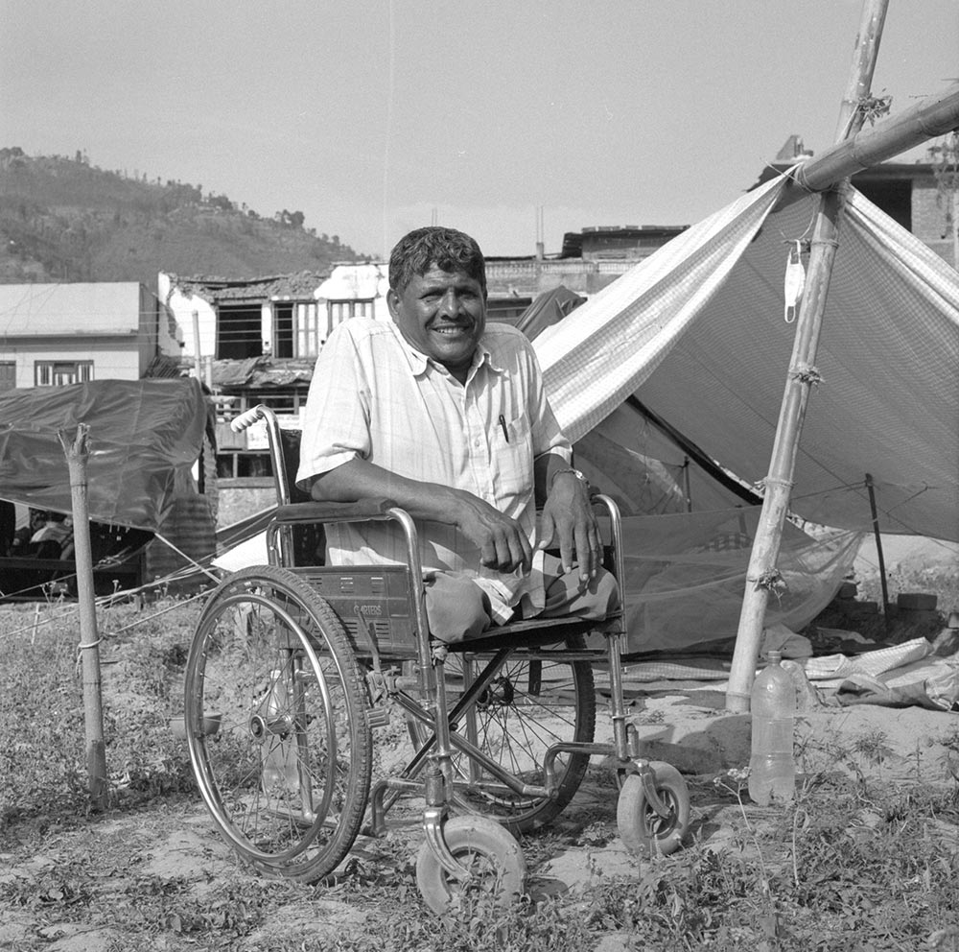
Recommendations
Scale up efforts towards the localization, domestication of the SDGs and at the same time ensure the mainstreaming of disability and gender equality in local policies and programs;
Invest in high quality, timely, reliable and disaggregated data for reporting on SDGs, and foster global partnerships on data such as Together we count to be counted, to ensure evidence based policy making;
Encourage States to fulfil their commitments to the United Nations Convention on the Rights of Persons with Disabilities as they implement the 2030 Agenda.

Slide 7
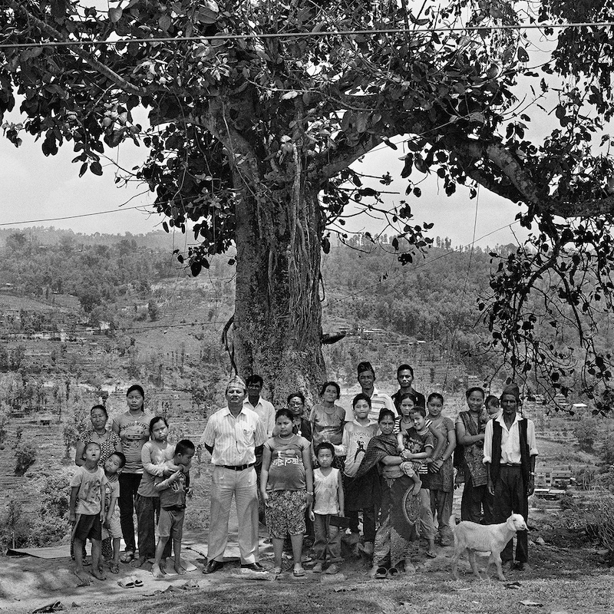
Conclusion
We must include everyone, especially the most left behind to address the challenges of all countries, including LDCs, LLDCs and MICs to truly create a sustainable and resilient world.

Slide 8
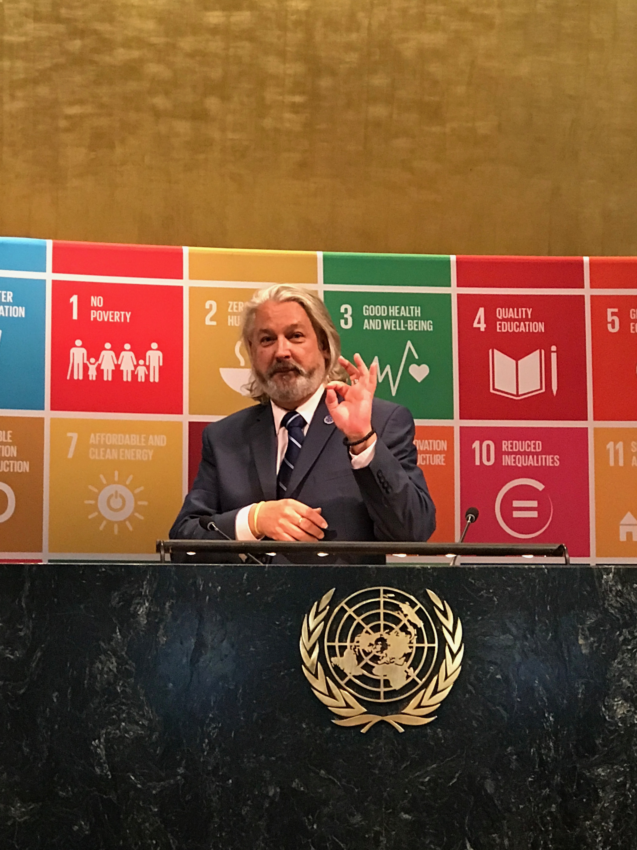
Thank You!

