Slide 1
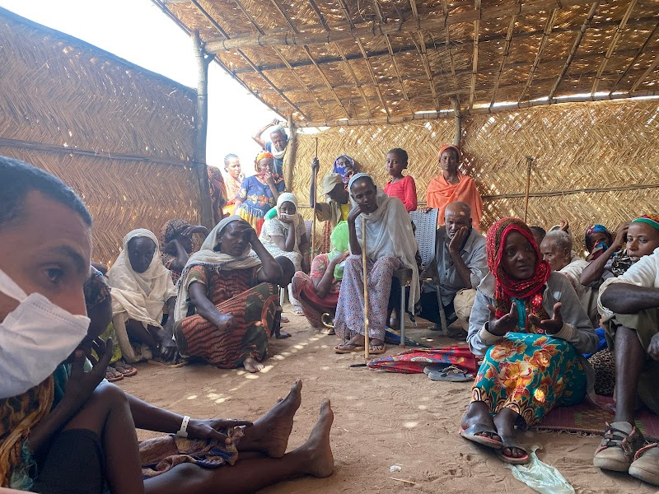
Tigray Refugees with Disabilities in Eastern Sudan Camps
October 2021
Meaningful participation and equal and just access

Slide 2
Objective of the Report
This report is commissioned by Islamic Relief Worldwide IRW in coordination with International Disability Alliance (IDA) to document the experiences of persons with disabilities affected by Tigray conflict currently residing in two refugee camps: Um Rakuba and Tunaydbah in Eastern Sudan, with a particular focus on women and children with disabilities.
The goal is to identify the challenges they faced in accessing the humanitarian response and identify practical recommendations to overcome these challenges, and to promote greater inclusion and participation of persons with disabilities in humanitarian action.
Meaningful participation and equal and just access

Slide 3
Methodology
The findings of this report were identified through qualitative methods including a desk review, interviews and focus group discussion.
Key informant interviews included three target groups: refugees with disabilities (including women, girls, children and older persons with disabilities), humanitarian actors including governmental authorities and the National Disability Council, as well as other organizations of Persons with Disabilities.
Field visits to Eastern Sudan refugees camps was conducted from March 21, 2021 to April 3, 2021
Meaningful participation and equal and just access

Slide 4
Data & Statistics
some Statistics of Ethiopian refugees in East Sudan as of August 1, 2021 shows that
Hamdayet 5,762 Refugees
Village 8 3,077 Refugees
Um Rakuba Camp 18,660 refugees- out of this number 571 are persons with disabilities
Tunaydbah Settlement 19,560 refugees- out of this number 1128 are persons with disabilities.
The Disaggregation Based on Age and Gender shows that 33 % are children (those between 0-17 years), with 10 % below the age of five. 63% are adults (18-59 years), 4% are elderly persons (+60 years), 61% are male and 39 % are female.
Meaningful participation and equal and just access

Slide 5
Coordination of Response
The humanitarian action response for Ethiopian Refugees in Sudan is co-led by UNHCR and Commissioner of Refugees (COR) with other humanitarian and development partners under the Refugee Consultation Forum (RCF).
The RCF is the main refugee coordination mechanism in Sudan, with more than 45 members, including: UN , INGOs, NGOs and government partners.
Also there are working groups within different sectors such as WASH and education.
The response is also supported by the UN Country Team and other humanitarian and development partners.
Response Plan finalized on 25 November, 2020 and publicly announced on 29 November 2020 in Khartoum.
Meaningful participation and equal and just access

Slide 6
Legal and policy framework
The analysis of the report is guided by the CRPD and other international frameworks on inclusion of persons with disabilities in humanitarian programmes.
The Charter on Inclusion of Persons with Disabilities in Humanitarian Action.
The IASC Guidelines on the Inclusion of Persons with Disabilities in Humanitarian Action set out how to effectively identify and respond to the needs and rights of persons with disabilities in humanitarian settings.
The UN Security Council Resolution 2475 that represents a clear political commitment towards mainstreaming disability across all UN pillars, including peace and security.
Sudan national legal and policy frameworks requires more improvement in order to adequately address the inclusion of persons with disability in Situations of risk and humanitarian emergencies measures.

Slide 7
Key findings of the report
The findings show the level of inclusion of Tigray refugees with disabilities in humanitarian assistance in Eastern Sudan refugees’ camps.
The findings identified the challenges faced by refugees with disabilities in accessing:
Identification & Registration
Barriers around access to information
Shelter
Wash
Food
Cash assistance
Health
Camp Management

Slide 8
Identification & Registration
The current system for refugee registration does not collect information on refugees with disabilities. “There are many problems in data collection, the staff often lacked disability awareness and technical expertise and knowledge to include information on refugees with disabilities, even when registering, refugees with disabilities said that they have not been asked about their needs, they have been asked about their health problems but nothing on their needs,” says Aaron, a refugee with disabilities
Meaningful participation and equal and just access

Slide 9
Barriers around access to information
Inaccessible information and communication systems on the availability of services or during the provision of services in the refugees camps.
They are not well informed about the available services or they do not know who and where to ask for assistance.
Meaningful participation and equal and just access

Slide 10
Shelter
Overcrowding and congestion in camps that is contributing to protection risks, including Gender-based violence (GBV) and increased exposure to exploitation
Physical inaccessibility to shelter which affects all aspects of their daily lives, particularly for those with physical and visual disabilities.
Long distances from essential services and facilities such as water sources, latrines, health centres and food distribution points
Lack of adequate lighting to support protection and physical safety of refugees with disability.
Meaningful participation and equal and just access

Slide 11
WASH
lack of WASH facilities which enable safe, dignified, and independent access.
Sites are overcrowded and there is a lack of access to safe drinking water.
The inaccessibility and distance of latrines from their settlement. Latrines has no handles, ropes or chairs that would enable persons with disabilities to use them without assistance. No latrines allocated for persons with disabilities or private facilities for those with limited mobility.
They complain about having to wait in line for all services including WASH without being prioritised.
Meaningful participation and equal and just access

Slide 12
WASH
lack of WASH facilities which enable safe, dignified, and independent access.
Persons with disabilities reported that they did not receive individual, comprehensive assessments in order to identify their specific assistance and protection needs especially in regards to WASH.
Lack of knowledge, awareness and technical capacity among WASH actors on how to communicate with and include persons with disabilities in WASH.
Many WASH organisations interviewed reported that “sector standards, guidelines and policies consider the requirements of persons with disabilities however, meaningful financial and other technical support are still needed to make those commitments a reality”.
Meaningful participation and equal and just access

Slide 13
Food
Refugees with disabilities reported that they received insufficient food rations, food distribution points were far from tents and that they had to line up for long time to receive their food.
Participants pointed out the lack of variety of food and the lack of consideration of individual needs for special food, in particular for children, older people and persons with health issues.
Meaningful participation and equal and just access

Slide 14
Cash Assistance
In Tigray refugee camps, some organisations provide monthly cash support. However, the stipend is not enough to cover basic needs, especially for persons with disability who have extra cost of disability such as replacement of assistive devices .
Others didn’t receive the cash support due to lack of information on cash registration processes and delivery mechanisms.
Meaningful participation and equal and just access

Slide 15
Health
The Research has documented some positive measures by humanitarian actors in collaboration with the government to ensure access to healthcare for refugees. However, our research indicates that most of these measures are not inclusive of and accessible for refugees with disabilities.
Specialised doctors and medicines are not available, they had to go to the hospital and they face a lot of barriers such as inaccessible and unaffordable transportation.
There are no rehabilitation services nor assistive devices.Some persons with disabilities lost their assistive devices when they fled, others state that they are damaged and that they can no longer use them.
Meaningful participation and equal and just access

Slide 16
Protection mainstreaming
An inter-agency team conducted a rapid protection assessment with refugees including persons with disabilities at Hamdayet transit centre. The main findings show that there is
lack of information around available service.
Girls and women not feeling safe due to rumours of GBV incidents,
The urgent request for hygiene kit to mitigate exposure to Covid-19.
No specific mechanisms are put in place to target refugees with disabilities. They didn’t receive information about protection reporting and response system nor the responsible organisation.

Slide 17
Protection mainstreaming
Many violation cases have been reported in both camps during the interviews, particularly with relation to the distributions of food and other items. Persons with disabilities have to do the queues like everyone else. However, queues are not respected and people with disabilities are scared of being pushed in crowds, which make them among the last people to receive aid.
Meaningful participation and equal and just access

Slide 18
Camp Management
Although refugees with disabilities represent a significant portion of the affected population in Tigray Camps, they have not been included in the elected committees or participated in their selection.
They were also facing attitudinal barriers. “Supervisors and managers of the camp hold negative attitudes towards persons with disabilities; when we tried to raise our concerns and voice our needs we face ignorance and neglect and sometimes they were not willing to hear us”
Meaningful participation and equal and just access

Slide 19
Recommendations to Humanitarian Actors
Urgent Recommendations
Urgently provide accessible informative materials and accessible channels of communications.
Urgently provide assistive devices and rehabilitation services .
Provide financial support in form of cash transfer.
Provide a diversity of food, especially for persons with disabilities with high support needs.
Meaningful participation and equal and just access

Slide 20
Recommendations to Humanitarian Actors
Mid-term recommendations
Establish an inclusive registration and data collection system.
Review sectoral policies and tools in line with IASC Guidelines on Disability Inclusion.
Ensure the meaningful participation of OPDs at all levels.
Enhance trustful relationship between refugees and humanitarian staff.
Identify and monitor barriers and enablers to their inclusion.
Ensure accessibility measures to camp infrastructure, services and information.
Promote inclusion in camp leadership and management.
Implement strategies to reduce disability-related stigma.
Meaningful participation and equal and just access

Slide 21
Recommendations to the government
Review policies and reform legal frameworks.
Improve the level of coordination with humanitarian actors.
Address the needs of persons with disabilities at the start of the emergency.
Require all service providers to implement universal design principles.
Build the capacity of OPDs to work on emergency response.
Meaningful participation and equal and just access

Slide 22
Recommendations to the United Nations
Raise awareness among UN and other humanitarian organisation about the national framework and services available for persons with disabilities.
Develop partnerships with OPDs and other organisations working in humanitarian action.
Meaningful participation and equal and just access

Slide 23
Recommendations for Organizations of Persons with Disabilities (OPDs)
Inclusion of displaced persons with disabilities in advocacy plans.
Invite displaced persons and refugees with disabilities to coordinate with humanitarian stakeholders and share information.
Establish partnership with humanitarian actors to support their inclusion.
Support mobilising displaced persons with disabilities.
Contribute to building the capacity of humanitarian actors and government officials.
Raise public awareness about the rights and needs of displaced persons with disabilities.
Meaningful participation and equal and just access

Slide 24
Tags for Social Media:
For more information and the full report follow up on social media;
@IDA_CRPD_Forum
@cbm_ireland
@HRW
@ICRC
@IRWorldwide
@SR_Disability
@OHCHR
#CivilSociety #OrganizationsOfPersonsWithDisabilities #CRPDArticle11 #SCResolution2475
Meaningful participation and equal and just access

